Slide 1
GCSE Religious Studies Theme E
Crime and Punishment
Name:

Slide 2
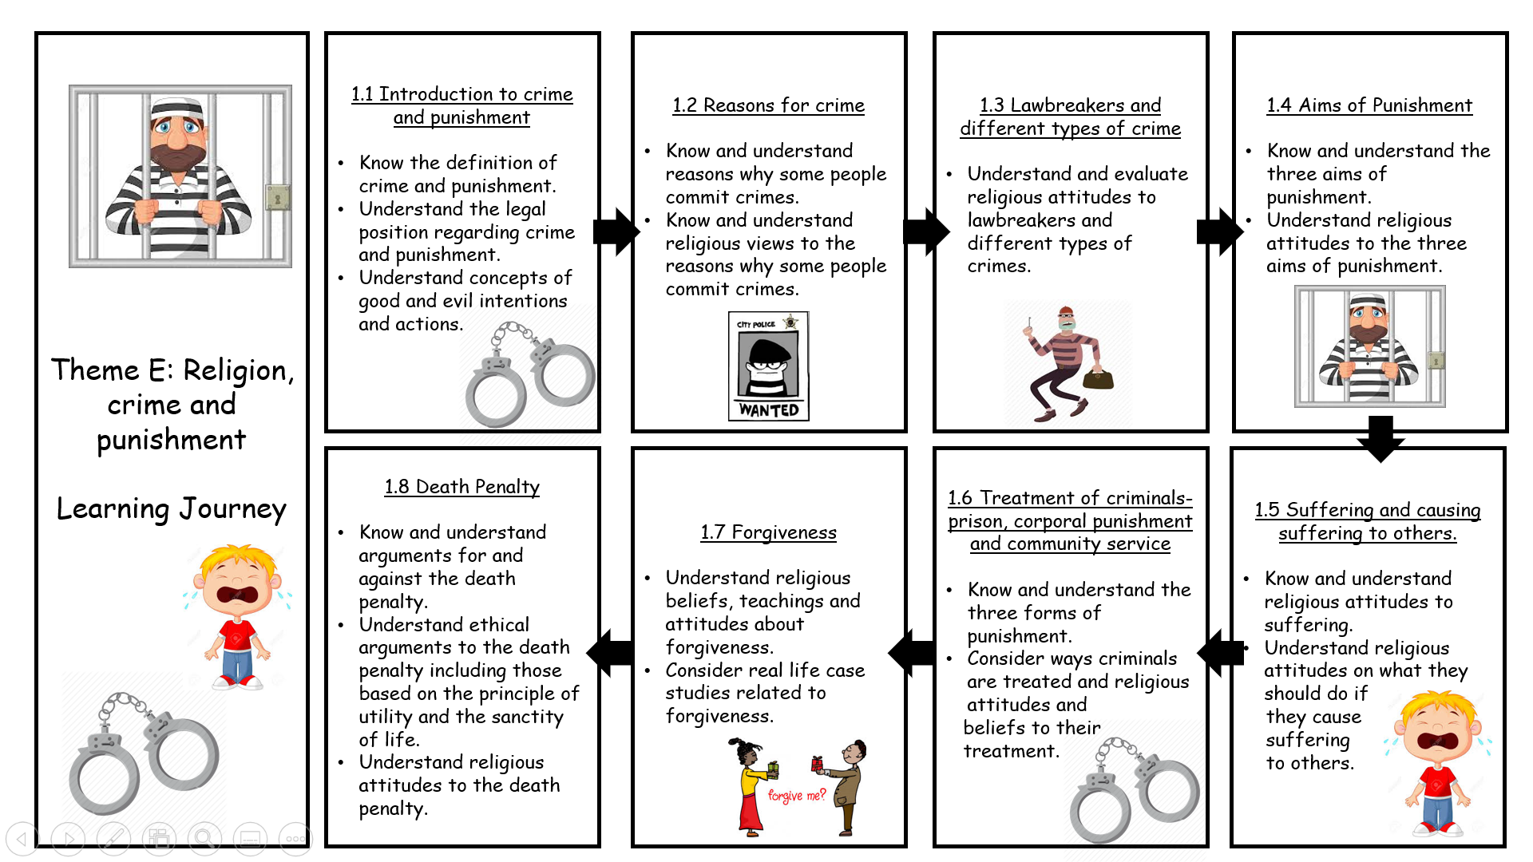
Theme E- Religion, Crime and Punishment-Work Booklet
Theme E- Religion, Crime and Punishment-Work Booklet
Link to the Textbook on Frog:
Christianity: https://drive.google.com/file/d/1STSi5fq_Jn5I9xYPklTDz0Ef1wGxb0Zs/view
Islam: https://drive.google.com/file/d/1_VI3xOIlzm6SBwqKi6FO8qvx326C8h0u/view

Slide 3
1.1 Introduction to crime and punishment
Christianity P142-143 Islam: 128-129
Know the definition of crime and punishment.
Understand the legal position regarding crime and punishment.
Understand concepts of good and evil intentions and actions.
Task A: Key Word Match- Research to help you/ Use the textbook
Crime
Punishment
Evil
Intention
Shari’ah Law
Opposite of good; a force or the personification of a negative power that is seen in many traditions as destructive and against God.
Something legally done to somebody as a result of being found guilty of breaking the law.
The plan that someone has before they act.
Islamic law based on the Qur’an, Hadith and the Sunnah.
An offence which is punishable by law.
Task B: What is crime? What is punishment?
Using the Christianity textbook (p142). Explain in your own words what the meaning of crime and punishment is. Use examples
Crime
Punishment
Task C: Complete the table, first you need to decide what punishment you would give for the crime. Then you need to research what the actual punishment is in the UK
The crime | Your punishment | Actual punishment
Steve stole a packet of crisps
Dave went into a shop and threatened the shop assistant with a knife for money and scratch cards
1

Slide 4
1.1 Introduction to crime and punishment
Christianity P142-143 Islam: 128-129
Know the definition of crime and punishment.
Understand the legal position regarding crime and punishment.
Understand concepts of good and evil intentions and actions.
James raped a young women on her way home from work.
Two teenage boys murdered a two year old, after the kidnapped him and tortured him to death
Samantha’s boyfriend constantly beats her up. One time she feared for her life, he hit him with an iron and killed him.
Terry, raped an 11 year old child.
Dorothy is 87 and refusing to pay her gas bill.
Malcolm is refusing to pay his parking fine.
Task D: Explain what the difference is between criminal law and civil law, including examples.
Criminal law
Civil law
2

Slide 5
1.1 Introduction to crime and punishment
Christianity P142-143 Islam: 128-129
Know the definition of crime and punishment.
Understand the legal position regarding crime and punishment.
Understand concepts of good and evil intentions and actions.
Task E: Using p143 (Christianity) Explain what evil actions and intentions are.
Explain what the main difference is between them. Leave the quote for now
Can it be both a crime and evil?
A crime may be evil as well, but not all evil is a crime.
For example, the act of murder is a crime against English Law, and it is also evil because it goes against the will of God, according to the Ten Commandments.
However, adultery is not a crime in England but a sin and evil to most religions.
Task F: Explain what the quote teaches Christians about good and evil actions and intentions
“ You have heard it was said that it was said to the people long ago, ‘You shall not murder’, and anyone who murders will be subject to judgement.”
Matthew 5:21-22
Christian views on crime and punishment
Many Christians would claim that there is no such thing as an evil person.
Human beings are not perfect and make mistakes.
However, the belief in original sin derived from the disobedience of Adam and Eve means that all humans have a tendency to do thins that are evil even though they are not evil themselves.
If God created people to be good, they are unlikely to do something unspeakably awful unless there was a specific, reason, for example a psychological illness.
If this is the case, they should receive treatment for their ill ness while being punished for their actions.
3

Slide 6
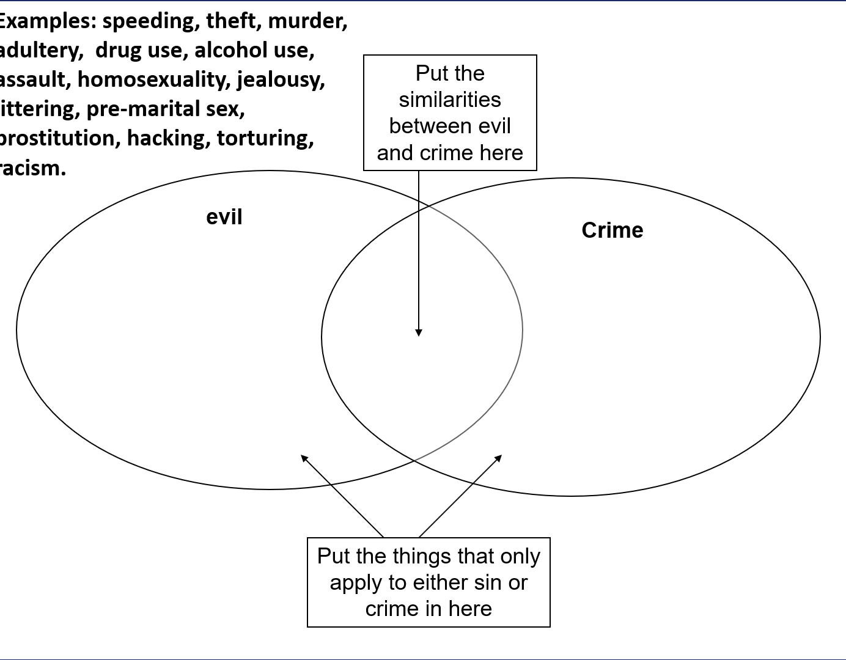
1.1 Introduction to crime and punishment
Christianity P142-143 Islam: 128-129
Know the definition of crime and punishment.
Understand the legal position regarding crime and punishment.
Understand concepts of good and evil intentions and actions.
Muslim views on crime and punishment
Muslims believe that evil is linked wit Satan (Iblis) who was originally created by God as a spirit called a jinn.
He was cursed by God for refusing to bow to Adam, the first man God created.
As a result Satan is now intent on tempting humans to choose to do wrong rather than right.
When Muslims speak about evil criminal actions, they usually mean that the offence is profoundly immoral and wicked as a result of giving into temptation.
Thus it is against the will of God.
Many Muslims would claim that human beings are not perfect and make mistakes.
Some do evil things, but this is because they have no resisted temptation and not because they are bad people.
The level of punishment considered for a crime in the UK may be determines by the reasons and circumstances behind the wrongdoing.
Under Shari’ah law the severity of a punishment is related to the seriousness of the religious value that has been breaches by the crime (for example to not kill, or to not commit adultery)
Shari’ah law puts great emphasis on the beliefs and intentions of a person, and even if you have thoughts of committing crime, it is considered as serious as committing the crime itself.
Task G: Complete the Venn diagram on evil and crime and their similarities.
I have given you some examples but see what others you can add.
4

Slide 7
1.1 Introduction to crime and punishment
Christianity P142-143 Islam: 128-129
Know the definition of crime and punishment.
Understand the legal position regarding crime and punishment.
Understand concepts of good and evil intentions and actions.
GCSE 2 Marker Practice Question:
Give two examples of crimes that are seen as evil
1)_________________________________________________________________
2) ________________________________________________________________
GCSE 4 Marker
Explain two contrasting beliefs about humans being evil
____________________________________________________________________________________________________________________________________
__________________________________________________________________
__________________________________________________________________
____________________________________________________________________________________________________________________________________
__________________________________________________________________
__________________________________________________________________
GCSE 5 Marker
Explain two religious beliefs about crime and punishment
Refer to a religious source/ quote in your answer
____________________________________________________________________________________________________________________________________
__________________________________________________________________
__________________________________________________________________
____________________________________________________________________________________________________________________________________
__________________________________________________________________
__________________________________________________________________
__________________________________________________________________
__________________________________________________________________
__________________________________________________________________
5

Slide 8
1.2 Reasons for crime
Christianity P144-145 Islam: 130-131
Know and understand reasons why some people commit crimes.
Know and understand religious views to the reasons why some people commit crimes.
Task A:
Why do people commit crime?
Task B: Key Word Match- Research to help you/ Use the textbook
Poverty
Mental illness
Addiction
Greed
Hate Crime
Wanting to possess wealth, good or items of value which are not needed.
Physical or mental dependency on a substance or activity which is very difficult to overcome.
A medical condition that affects a person’s feelings, emotions or moods, and perhaps their ability to relate to others.
Being without money, food or other basic needs of life (being poor)
Crime, often including violence, that are usually targeted at a person because of their race, religion, sexuality, disability or gender.
Is committing a crime always wrong?
Some people believe that crime is only wrong depending on why is it committed.
Sometimes it is due to selfishness, where sometimes it may be due to other circumstances which make it more understandable.
For Christians- they rarely believe that there is an acceptable reason for committing crimes, especially as they believe that God has put law making authorities in place. They also believe laws are important to keep order in society so that people can live in peace.
Muslims also believe that there is little acceptance for committing crimes, especially in countries that follow Shari’ah law that comes from the Qur’an, the Sunnah and Hadith. It creates peace and order in society.
6

Slide 9
1.2 Reasons for crime
Christianity P144-145 Islam: 130-131
Know and understand reasons why some people commit crimes.
Know and understand religious views to the reasons why some people commit crimes.
Task C: Explain what the quotes teach Christians and Muslims about committing crimes
“Let everyone be subject to the governing authorities, for there is no authority except that which God has established.”
Romans 13:1
“Those who do not judge according to what God has revealed are doing grave wrong.”
Qur’an 5:45
There are only 7 main categories why people commit crimes
Task D: Using p144-145 (Christianity) and p130-131 (Islam) Explain how the reason can lead to people committing crimes, add examples and explain Christian and Muslim views to it.
I have included the quotes so explain how they link. If there is nothing in the textbook do some additional research
Reason | How does it lead to crime? | Example | Christian views | Muslim views
Poverty |  |  | “Focusing on poverty and sacrificing for the poor are the heart of the gospel. If Christians don’t dig deep and generously open up their wallets, they do not have a genuine faith.” Pope Francis
7

Slide 10
1.2 Reasons for crime
Christianity P144-145 Islam: 130-131
Know and understand reasons why some people commit crimes.
Know and understand religious views to the reasons why some people commit crimes.
Reason | How does it lead to crime? | Example | Christian views | Muslim views
Upbringing
Mental illness
Addiction
Greed |  |  |  | “Competing for more distracts you until you go into your graves.” Qur’an 102:1-2
Hate
Opposition to an unjust law
8

Slide 11
1.2 Reasons for crime
Christianity P144-145 Islam: 130-131
Know and understand reasons why some people commit crimes.
Know and understand religious views to the reasons why some people commit crimes.
GCSE 2 Marker Practice Question:
Give two reasons why people commit crimes
1)_________________________________________________________________
2) ________________________________________________________________
GCSE 5 Marker
Explain two religious beliefs about committing a crime due to an unfair law
Refer to a religious source/ quote in your answer
____________________________________________________________________________________________________________________________________
__________________________________________________________________
__________________________________________________________________
____________________________________________________________________________________________________________________________________
__________________________________________________________________
__________________________________________________________________
__________________________________________________________________
__________________________________________________________________
__________________________________________________________________
Task: GCSE 12 Marker- Make a plan and write it up
“Poverty is the only acceptable reason to commit a crime” Evaluate this statement
Agree- Poverty is the only acceptable reason | Disagree- It is not acceptable/ there are others that are acceptable
9

Slide 12
GCSE 12 Marker- “Poverty is the only acceptable reason to commit a crime”
__________________________________________________________________
__________________________________________________________________
____________________________________________________________________________________________________________________________________
__________________________________________________________________
____________________________________________________________________________________________________________________________________
__________________________________________________________________
__________________________________________________________________
__________________________________________________________________
__________________________________________________________________
__________________________________________________________________
__________________________________________________________________
__________________________________________________________________
__________________________________________________________________
__________________________________________________________________
____________________________________________________________________________________________________________________________________
__________________________________________________________________
__________________________________________________________________
__________________________________________________________________
__________________________________________________________________
__________________________________________________________________
__________________________________________________________________
__________________________________________________________________
__________________________________________________________________
__________________________________________________________________
__________________________________________________________________
__________________________________________________________________
__________________________________________________________________
____________________________________________________________________________________________________________________________________
10

Slide 13
____________________________________________________________________________________________________________________________________
__________________________________________________________________
__________________________________________________________________
____________________________________________________________________________________________________________________________________
__________________________________________________________________
____________________________________________________________________________________________________________________________________
__________________________________________________________________
__________________________________________________________________
__________________________________________________________________
__________________________________________________________________
__________________________________________________________________
__________________________________________________________________
__________________________________________________________________
__________________________________________________________________
__________________________________________________________________
____________________________________________________________________________________________________________________________________
__________________________________________________________________
__________________________________________________________________
__________________________________________________________________
__________________________________________________________________
__________________________________________________________________
__________________________________________________________________
__________________________________________________________________
__________________________________________________________________
__________________________________________________________________
__________________________________________________________________
__________________________________________________________________
__________________________________________________________________
____________________________________________________________________________________________________________________________________
11

Slide 14
1.3 Lawbreakers and different types of crime
Christianity P146-147 Islam: 132-133
Understand and evaluate religious attitudes to lawbreakers and different types of crimes.
Task A: Imagine a society which has no laws- you could do whatever you wanted.
Would you like to live there? Explain why.
What would be good and bad about it?
Task B:
Why do we have/ need laws?
Christian attitudes to law breakers
Christians are against people breaking the laws without just cause.
Christians must challenge laws that they think are morally wrong.
All offenders must be presumed innocent until they are proven guilty and the court decides. If they are innocent, they go back to their normal lives, if not they will receive a punishment.
Some Christians believe that punishment should be as severe as the crime committed.
Law breakers have rights, and these should be protected, even while they are being punished.
Christians believe that inhumane treatment of offenders is wrong.
Most Christians believe that offenders should be helped to change so that they do not reoffend.
In the parable of the sheep and goats- Jesus teaches about the well treatment of prisoners.
Christians should show compassion to offenders and should help them to understand their wrongdoings.
12

Slide 15
1.3 Lawbreakers and different types of crime
Christianity P146-147 Islam: 132-133
Understand and evaluate religious attitudes to lawbreakers and different types of crimes.
Task C: Explain what the quote teaches Christians about how to treat lawbreakers
“Come, you who are blessed by my Father; take your inheritance, the Kingdom prepared for you since the creation of the world. For… I was in prison and you came to visit me.”
Matthew 25:34-36
Muslim attitudes to lawbreakers
Muslims are against people committing crimes.
God has made it clear that Shari’ah law has to be obeyed, as should any just or fair law in non-Shari’ah countries.
Some Muslim’s believe that the punishment should reflect the fact that the lawbreaker’s actions are unacceptable.
Punishments under the Shari’ah law are severe but they do not apply in the UK. Example, chopping hands off thieves.
Task C: Explain what the quote teaches Muslims about how to treat lawbreakers
“God commands justice… and prohibits wrongdoing, and injustice…”
Qur’an 16:90
There are many different types of crimes, but some are more serious and worse that others. More deserve severe punishments than others.
Those are; Hate crimes, Murder and theft
Task D: Complete the grid using p147 (Christianity) and p132-133 (Islam)
Christian attitudes to different types of laws
Murder “Love thy neighbour” Mark 12:31 | Hate Crime “Love thy neighbour” Mark 12:31 “There is neither Jew not Gentile, slave nor free, male or female, you are all one in Christ Jesus.” Galatians 3:28 | Theft
13

Slide 16
1.3 Lawbreakers and different types of crime
Christianity P146-147 Islam: 132-133
Understand and evaluate religious attitudes to lawbreakers and different types of crimes.
Muslims attitudes to different types of laws
Murder | Hate Crimes | Theft
Shari’ah law categories of crime
Shari’ah law classifies crimes into four types:
Unforgivable crimes (Hadud)- crimes such as adultery, theft, drinking alcohol or taking drugs, rebellion against the state- all of which are prohibited in the Qur’an.
Forgivable crimes (Al-Jynayaat)- Crimes against the right of the individual, such as bodily harm and murder, for which the victim or their family can gain credit by showing mercy.
Community crimes (Al Ta’azir)- Crimes that affect the community such as fraud and antisocial behavior.
Crimes against the state law (Al-Mukhalafat) –Crimes against a law of the state (rather than the Qur’an) such as parking offences and speeding
GCSE 5 Marker
Explain two religious beliefs about hate crime
Refer to a religious source/ quote in your answer
____________________________________________________________________________________________________________________________________
__________________________________________________________________
__________________________________________________________________
____________________________________________________________________________________________________________________________________
__________________________________________________________________
__________________________________________________________________
__________________________________________________________________
__________________________________________________________________
__________________________________________________________________
14

Slide 17
1.3 Lawbreakers and different types of crime
Christianity P146-147 Islam: 132-133
Understand and evaluate religious attitudes to lawbreakers and different types of crimes.
GCSE 2 Marker Practice Question:
Give two reasons why we have laws
1)_________________________________________________________________
2) ________________________________________________________________
GCSE 4 Marker
Explain two contrasting religious responses to lawbreakers
____________________________________________________________________________________________________________________________________
__________________________________________________________________
__________________________________________________________________
____________________________________________________________________________________________________________________________________
__________________________________________________________________
__________________________________________________________________
__________________________________________________________________
GCSE 5 Marker
Explain two religious beliefs about murder
Refer to a religious source/ quote in your answer
____________________________________________________________________________________________________________________________________
__________________________________________________________________
__________________________________________________________________
____________________________________________________________________________________________________________________________________
__________________________________________________________________
__________________________________________________________________
__________________________________________________________________
__________________________________________________________________
__________________________________________________________________
15

Slide 18
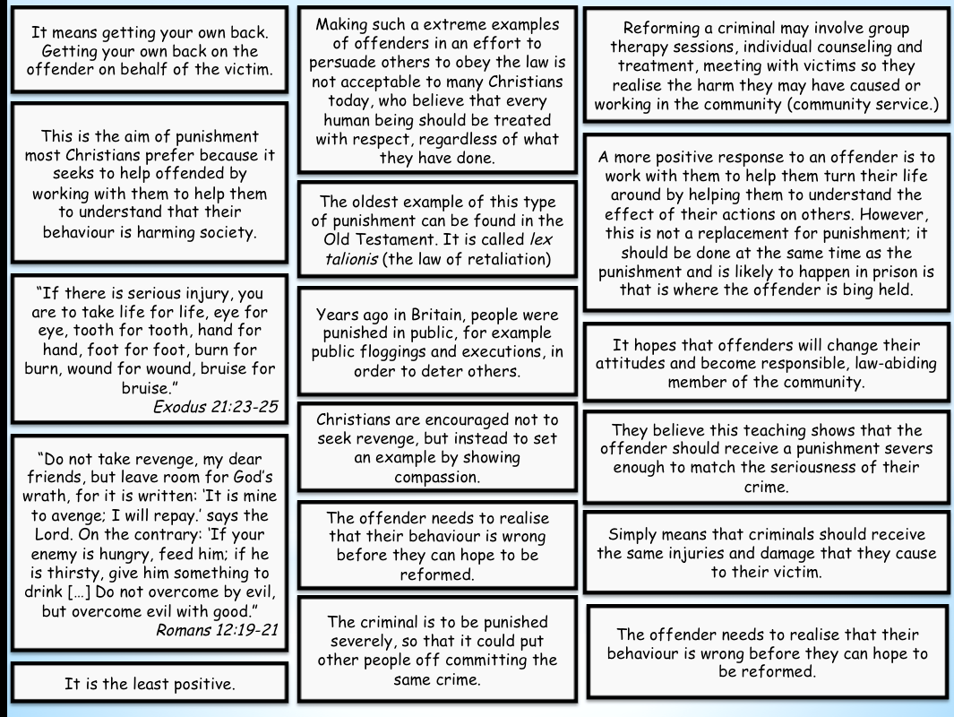
1.4 Aims of Punishment
Christianity P148-149 Islam: 136-137
Know and understand the three aims of punishment.
Understand religious attitudes to the three aims of punishment.
Task A: Key Word Match- Research to help you/ Use the textbook
Retribution
Deterrence
Reformation
An aim of punishment- to get your own back; ‘an eye for an eye’.
An aim of punishment- to change someone’s behavior for the better.
An aim of punishment- to put people off committing crimes.
Whenever a punishment is imposed by a court, the judge has to consider what purpose the punishment will serve.
In the UK, no matter how severe the punishment, it is intended as a positive action- to protect society to assist the offender, to stop others from making the same mistake, or a combination of these.
It is generally acknowledged that punishments should not cause unnecessary, international harm to the offended.
In the past, it hasn’t always been this way and in some countries, it still isn’t.
Task B: Create a key- use this key to colour in the sheet- work out if the statement/quote/ explanation is talking about retribution, deterrence or reformation.
Christian views
PYT- Explain what the quotes mean and how the link to the aim of punishment
16

Slide 19
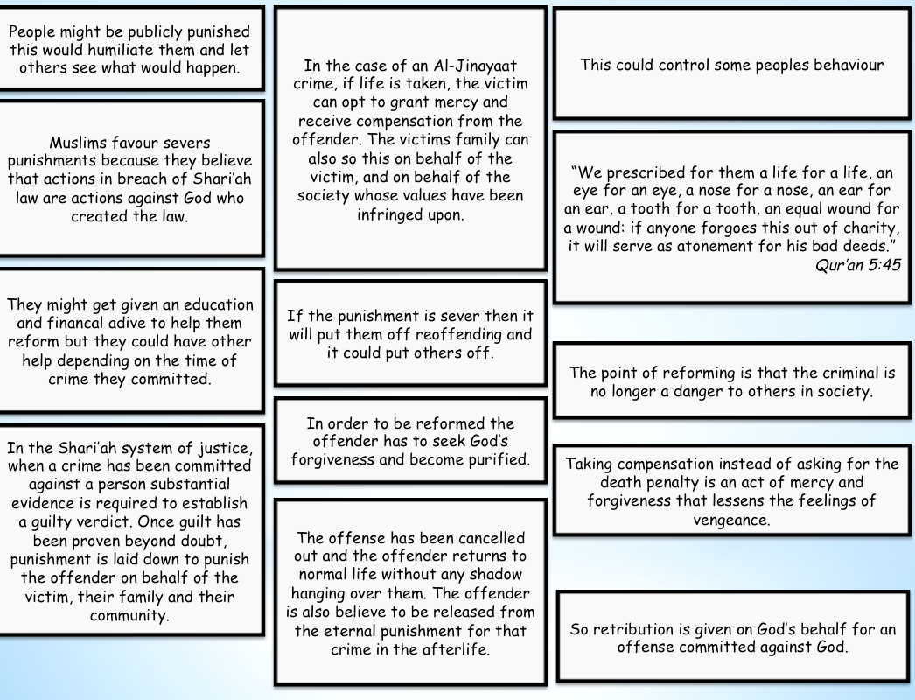
1.4 Aims of Punishment
Christianity P148-149 Islam: 136-137
Know and understand the three aims of punishment.
Understand religious attitudes to the three aims of punishment.
Muslim views
PYT- Explain what the quotes mean and how the link to the aim of punishment
Judgement and Punishment
Reform: “The idea that punishments should try to change criminals so that they will not commit crimes again”. Some see punishment to reform offenders, so they do not want to break the law again. Reform can include training and education so offenders will not need to re-offend.​
Deterrence: ‘The idea that punishments will be of such a nature that they will put people off (deter) committing crimes.’​The idea of deterrence is preventative. The punishment given is severe enough to deter others from committing the same offence or possibly re-offending.​
Retribution: ‘The idea that punishments should make criminals pay for what they have done wrong.’​ Some believe that a person should pay for what they have done. This gives society and the victims of crime a feeling of justice. Punishments should also match the severity of the crime.​
Task C: Complete the 3 aims sheet and fill it in with what you think which of the 3 forms of punishment it is and what the positives and negatives are for that.
Crime | Punishment | Which of the 3 aims is this and why? | Positives and Negatives of this punishment
Driving twice the legal limit of alcohol | Years driving ban and £ 1000 fine
Shop lifting- First offence | Probation for a year
17

Slide 20
1.4 Aims of Punishment
Christianity P148-149 Islam: 136-137
Know and understand the three aims of punishment.
Understand religious attitudes to the three aims of punishment.
Crime | Punishment | Which of the 3 aims is this and why? | Positives and Negatives of this punishment
Burglary- 3rd offence | 6 months imprisonment
Drunk and Disorderly | 48 hours community service
Antisocial behaviour | Exclusion from Neighbourhood
Murder ( USA) | Death Penalty
Handling stolen goods | Electronic tagging
Rape | Prison for 5 years
Beating up your partner | Restraining order
Task: GCSE 12 Marker- Make a plan and write it up
“Deterrence is the best aim of punishment” Evaluate this statement
Agree- Deterrence is the best | Disagree- It is not the best/ others are better
18

Slide 21
GCSE 12 Marker- “Deterrence is the best aim of punishment”
__________________________________________________________________
__________________________________________________________________
____________________________________________________________________________________________________________________________________
__________________________________________________________________
____________________________________________________________________________________________________________________________________
__________________________________________________________________
__________________________________________________________________
__________________________________________________________________
__________________________________________________________________
__________________________________________________________________
__________________________________________________________________
__________________________________________________________________
__________________________________________________________________
__________________________________________________________________
____________________________________________________________________________________________________________________________________
__________________________________________________________________
__________________________________________________________________
__________________________________________________________________
__________________________________________________________________
__________________________________________________________________
__________________________________________________________________
__________________________________________________________________
__________________________________________________________________
__________________________________________________________________
__________________________________________________________________
__________________________________________________________________
__________________________________________________________________
____________________________________________________________________________________________________________________________________
19

Slide 22
____________________________________________________________________________________________________________________________________
__________________________________________________________________
__________________________________________________________________
____________________________________________________________________________________________________________________________________
__________________________________________________________________
____________________________________________________________________________________________________________________________________
__________________________________________________________________
__________________________________________________________________
__________________________________________________________________
__________________________________________________________________
__________________________________________________________________
__________________________________________________________________
__________________________________________________________________
__________________________________________________________________
__________________________________________________________________
____________________________________________________________________________________________________________________________________
__________________________________________________________________
__________________________________________________________________
__________________________________________________________________
__________________________________________________________________
__________________________________________________________________
__________________________________________________________________
__________________________________________________________________
__________________________________________________________________
__________________________________________________________________
__________________________________________________________________
__________________________________________________________________
__________________________________________________________________
____________________________________________________________________________________________________________________________________
20

Slide 23
1.5 Suffering and causing suffering to others.
Christianity P150-151 Islam: 134-135
Know and understand religious attitudes to suffering.
Understand religious attitudes on what they should do if they cause suffering to others.
For many people, suffering is an unfortunate part of living.
It may be caused by something natural, such as illness, or it may be due to how people have behaved or how somebody else has behaved.
Task A: Write down everything you already know about Christian and Muslim views towards suffering.
Where does it come from?
Why do we have it?
Why do some think God allows it?
How does it link to the problem of evil?
Task B: Key Word Match- Research to help you/ Use the textbook
Free Will
Suffering
The belief that God gives people the opportunity to make decisions for themselves in knowledge of the consequences their decisions may cause.
Suffering is the state of undergoing pain, distress or hardship.
21

Slide 24
1.5 Suffering and causing suffering to others.
Christianity P150-151 Islam: 134-135
Know and understand religious attitudes to suffering.
Understand religious attitudes on what they should do if they cause suffering to others.
Task C: Answer the questions on Christiana and Muslim views towards suffering
Christianity (P150-151) and Islam (134-135) Explain the quotes.
Ignore the case studies for now- we will look at them later
Christian attitudes towards suffering
What do Christians think about suffering? “We also glory in our sufferings, because we know that suffering perseverance, character, and character, hope.” Romans 5:3-4 | How do Christians look to Jesus during times of suffering? “We are never really happy until we try to brighten the lives of others.” Helen Keller
Why do some people question God? How does suffering link to Free Will? | What are the consequences of suffering?
Muslim attitudes towards suffering
What do Muslims believe? | What do Muslims consider suffering to be? “You are sure to be tested through your possessions and persons; you are sure to hear much that is hurtful…If you are steadfast and mindful of God, that is the best course.” Qur’an 3:186
22

Slide 25
1.5 Suffering and causing suffering to others.
Christianity P150-151 Islam: 134-135
Know and understand religious attitudes to suffering.
Understand religious attitudes on what they should do if they cause suffering to others.
What does Islam teach about enduring suffering? | Why is it wrong to blame God?
Task D: Watch the two videos on the Charleston Church Shooting and answer the questions
https://www.youtube.com/watch?v=XdSLp4MmDRM
https://www.youtube.com/watch?v=Ozx0agiAFFQgo
What happened?
How do Christians respond to this?
This will be helpful for your forgiveness topic too!
Task E: Watch the two videos on the Chapel Hill shooting and answer the questions
https://www.youtube.com/watch?v=51I8vXrWagI
What happened?
How does this link to hate crime?
23

Slide 26
1.5 Suffering and causing suffering to others.
Christianity P150-151 Islam: 134-135
Know and understand religious attitudes to suffering.
Understand religious attitudes on what they should do if they cause suffering to others.
Christian views on causing suffering to others
Christians are against causing suffering to others.
Jesus taught that humans should love each other and care for those in trouble.
He even spoke out about using violence in self-defense because of the further suffering that the retaliation may cause.
However no human is perfect, so it is inevitable that Christians cause suffering, often by accident or because of their mines are troubled for some reason.
When Christians have caused suffering it is important that Christians are honest to themselves, to other people and to God, and work at repairing the damage they may have caused.
It is important that relationships are restored
Task F: Explain what the quote teaches Christians about causing suffering to others
“One of (the disciples) struck the servant of the High Priest, cutting off his right ear. But Jesus answered, ‘No more of this!’ And he touched the man’s ear and healed him.”
Luke 22:50-51
This quote was during the arrest of Jesus.
While people cannot perform physical healing in the same way. They should try to heal the emotional and spiritual suffering caused.
Muslim views on causing suffering to others
Causing suffering to others is against the teaching of Islam.
Muslims share an identity with all other Muslims within the worldwide community of Muslims (ummah) caring and providing for all, therefore they should not cause others to suffer.
However no human is perfect, some will cause suffering either by accident of on purpose.
Muslims believe that there are many tests and temptations in life and Muslims should be honest and repair the damages they may have caused.
They must try to restore relationships.
God said that he will forgive anyone who is sincere in forgiveness and he will show mercy like he did to Adam and Eve when they were tempted by Iblis to eat the forbidden fruit.
Task G: Explain what the quote teaches Muslims about causing suffering to others and helping others
“Be compassionate towards the destitute.”
Hadith
24

Slide 27
1.5 Suffering and causing suffering to others.
Christianity P150-151 Islam: 134-135
Know and understand religious attitudes to suffering.
Understand religious attitudes on what they should do if they cause suffering to others.
GCSE 4 Marker
Explain two reasons why religious believers will try and not cause suffering to others
____________________________________________________________________________________________________________________________________
__________________________________________________________________
__________________________________________________________________
____________________________________________________________________________________________________________________________________
__________________________________________________________________
__________________________________________________________________
__________________________________________________________________
__________________________________________________________________
__________________________________________________________________
GCSE 5 Marker
Explain two religious beliefs about suffering
Refer to a religious source/ quote in your answer
____________________________________________________________________________________________________________________________________
__________________________________________________________________
__________________________________________________________________
____________________________________________________________________________________________________________________________________
__________________________________________________________________
__________________________________________________________________
__________________________________________________________________
__________________________________________________________________
__________________________________________________________________
__________________________________________________________________
__________________________________________________________________
__________________________________________________________________
25

Slide 28
1.6 Treatment of criminals- prison, corporal punishment and community service
Christianity P152-153 Islam: 138-139
Know and understand the three forms of punishment.
Consider ways criminals are treated and religious attitudes and beliefs to their treatment.
Task A:
Name as many types of punishment as you can.
Use the video to help: https://www.truetube.co.uk/film/crime-punishment
Task B: Key Word Match- Research to help you/ Use the textbook
Prison
Corporal Punishment
Community service
A secure building where offenders are kept for a period of time set by a judge.
A way of punishing offenders by making them do unpaid work for/ in the community.
Punishment of an offender by causing them physical pain- now illegal in the UK.
How should criminals be treated?
In UK law, those punished should be treated with dignity.
Even though they have been found guilty of a crime this does not justify ill treatment.
This is supported by the Human Right- Punishment should not cause physical harm to the person who is being punished.
Punishment should help change a criminal (reformation) for both the individual and for the benefit of society.
All criminals are treated equally and have the same rights as everyone else- one of the principles that underpins the UK legal system.
26

Slide 29
1.6 Treatment of criminals- prison, corporal punishment and community service
Christianity P152-153 Islam: 138-139
Know and understand the three forms of punishment.
Consider ways criminals are treated and religious attitudes and beliefs to their treatment.
Task C: Explain why some people say this is the wrong way to treat criminals
Task D: Complete the boxes on Christian and Muslim views towards prison, community service and corporal punishment. Use p152-153 (Christianity) and p138-138 (Islam) Explain quotes
 | What is it? Why is it used? What form of punishment? | Christian views.. | Muslim views…
Prison
Community Service
27

Slide 30
1.6 Treatment of criminals- prison, corporal punishment and community service
Christianity P152-153 Islam: 138-139
Know and understand the three forms of punishment.
Consider ways criminals are treated and religious attitudes and beliefs to their treatment.
Corporal punishment |  | “He who spares the rod hates their children, but the one who loves their children is careful to discipline them.” | “Cut off the hands of thieves, whether they are man or woman, as punishment for what they have done- a deterrent from God.”
Task E: Write down 3 positives and 3 negative of the punishments
 | Positives | Negatives
Prison
Corporal Punishment
Community service
Task F: What other alternative types of punishments are these? Why could they be better or less effective?
28

Slide 31
1.6 Treatment of criminals- prison, corporal punishment and community service
Christianity P152-153 Islam: 138-139
Know and understand the three forms of punishment.
Consider ways criminals are treated and religious attitudes and beliefs to their treatment.
GCSE 4 Marker
Explain two contrasting views to prison as a form of punishment.
____________________________________________________________________________________________________________________________________
__________________________________________________________________
__________________________________________________________________
____________________________________________________________________________________________________________________________________
__________________________________________________________________
__________________________________________________________________
__________________________________________________________________
__________________________________________________________________
__________________________________________________________________
GCSE 5 Marker
Explain two religious views to corporal punishment
Refer to a religious source/ quote in your answer
____________________________________________________________________________________________________________________________________
__________________________________________________________________
__________________________________________________________________
____________________________________________________________________________________________________________________________________
__________________________________________________________________
__________________________________________________________________
__________________________________________________________________
__________________________________________________________________
__________________________________________________________________
__________________________________________________________________
__________________________________________________________________
__________________________________________________________________
29

Slide 32
1.7 Forgiveness
Christianity P154-155 Islam: 140-141
Understand religious beliefs, teachings and attitudes about forgiveness.
Consider real life case studies related to forgiveness.
Task A: What could you forgive?
Try and rank them in order from most forgivable to least.
Task B: Explain your top and bottom choice and why you think they are the easiest and hardest to forgive.
Task C: Key Word Match- Research to help you/ Use the textbook
Forgiveness
Showing grace and mercy and pardoning someone for what they have done wrong.
Christian views to forgiveness
Forgiveness is a core belief in Christianity.
Jesus emphasized the importance of forgiveness and taught Christians that they should forgive others regardless of what they have done.
Christians believe that in turn, God will forgive them.
The Lord’s prayer (Our father) shows the importance of forgiveness.
Christians would argue that forgiveness is not a replacement for punishment.
It is possible for both to forgive somebody who has committed murder and to believe that justice is done when they are sentenced to a long period of imprisonment.
Jesus gets asked about how many times we should forgive, and he tells the disciples countless times.
The Church interprets seventy-seven times as an unlimited amount.
Therefore there is no maximum times a person should be forgiven.
Christians believe that there is no limit on the love that God shows to them and they should show to others, so there can be no limit to forgiveness.
Even when Jesus was being crucified, Jesus said to those crucifying him.
Christians believe that in their lives they should follow the example of Jesus.
Christians believe forgives is easier for the victim when the offender shows that they are sorry and want to change their ways.
30

Slide 33
1.7 Forgiveness
Christianity P154-155 Islam: 140-141
Understand religious beliefs, teachings and attitudes about forgiveness.
Consider real life case studies related to forgiveness.
Task D: Explain the quotes and what they teach Christians about forgiveness
“Forgive us our sins, as we forgive those who sin against us.”
The Lord’s prayer
“Lord, how many times shall I forgive my brother when he sins against me? Up to seven times?’ Jesus answered, ‘I tell you, not seven times, but seventy-seven times.”
Matthew 18:21-22
“Father forgive them, for they do not know what they are doing.”
Luke 23:34
Task E: Watch the video of the parable of the unforgiving servant
https://www.youtube.com/watch?v=n-Dl5dqLz5M
Explain what happens
Explain what this teaches Christians about forgiveness
31

Slide 34
1.7 Forgiveness
Christianity P154-155 Islam: 140-141
Understand religious beliefs, teachings and attitudes about forgiveness.
Consider real life case studies related to forgiveness.
Task F: Complete the questions on Muslim views towards forgiveness. Use p140 to help you.
Explain the meaning of the quotes.
Muslim views on forgiveness
What does punishment do according to Muslims? | What are the two categories forgiveness falls into in Islamic beliefs? “Let them pardon and forgive. Do you not wish that God should forgive you? God is most forgiving and merciful.” Qur’an 24:22 “Pardon each other’s faults and [God] will grant you honour.” Hadith
Task G: Case Study: Maureen Greaves- Watch the video and explain what happened to her and explain how it links to forgiveness
https://www.youtube.com/watch?v=gzmOamXwHA8
32

Slide 35
1.7 Forgiveness
Christianity P154-155 Islam: 140-141
Understand religious beliefs, teachings and attitudes about forgiveness.
Consider real life case studies related to forgiveness.
Task H: Case Study: Forgiving a violent criminal. Using the newspaper article. Summarise the story on forgiveness.
https://www.theguardian.com/world/2014/apr/25/interview-samereh-alinejad-iranian-mother-spared-sons-killer?CMP=share_btn_link
Success Criteria:
Explain what happened.
Explain what it teaches about forgiveness.
Why might it be hard for people to forgive?
Task I: Why do some people say that forgiveness is weakness? Explain
Do you agree? Explain your views
Why might someone disagree with you?
34

Slide 36
1.7 Forgiveness
Christianity P154-155 Islam: 140-141
Understand religious beliefs, teachings and attitudes about forgiveness.
Consider real life case studies related to forgiveness.
GCSE 5 Marker
Explain two religious beliefs about forgiveness
Refer to a religious source/ quote in your answer
____________________________________________________________________________________________________________________________________
__________________________________________________________________
__________________________________________________________________
____________________________________________________________________________________________________________________________________
__________________________________________________________________
__________________________________________________________________
__________________________________________________________________
__________________________________________________________________
__________________________________________________________________
__________________________________________________________________
__________________________________________________________________
__________________________________________________________________
Task: GCSE 12 Marker- Make a plan and write it up
“Forgiveness is weakness” Evaluate this statement
Agree- it is weakness | Disagree- it is not weakness
34

Slide 37
GCSE 12 Marker- “Forgiveness is weakness”
__________________________________________________________________
__________________________________________________________________
____________________________________________________________________________________________________________________________________
__________________________________________________________________
____________________________________________________________________________________________________________________________________
__________________________________________________________________
__________________________________________________________________
__________________________________________________________________
__________________________________________________________________
__________________________________________________________________
__________________________________________________________________
__________________________________________________________________
__________________________________________________________________
__________________________________________________________________
____________________________________________________________________________________________________________________________________
__________________________________________________________________
__________________________________________________________________
__________________________________________________________________
__________________________________________________________________
__________________________________________________________________
__________________________________________________________________
__________________________________________________________________
__________________________________________________________________
__________________________________________________________________
__________________________________________________________________
__________________________________________________________________
__________________________________________________________________
____________________________________________________________________________________________________________________________________
35

Slide 38
____________________________________________________________________________________________________________________________________
__________________________________________________________________
__________________________________________________________________
____________________________________________________________________________________________________________________________________
__________________________________________________________________
____________________________________________________________________________________________________________________________________
__________________________________________________________________
__________________________________________________________________
__________________________________________________________________
__________________________________________________________________
__________________________________________________________________
__________________________________________________________________
__________________________________________________________________
__________________________________________________________________
__________________________________________________________________
____________________________________________________________________________________________________________________________________
__________________________________________________________________
__________________________________________________________________
__________________________________________________________________
__________________________________________________________________
__________________________________________________________________
__________________________________________________________________
__________________________________________________________________
__________________________________________________________________
__________________________________________________________________
__________________________________________________________________
__________________________________________________________________
__________________________________________________________________
____________________________________________________________________________________________________________________________________
36

Slide 39
1.8 Death Penalty
Christianity P156-157 Islam: 142-143
Know and understand arguments for and against the death penalty.
Understand ethical arguments to the death penalty including those based on the principle of utility and the sanctity of life.
Understand religious attitudes to the death penalty.
Task A: Key Word Match- Research to help you/ Use the textbook
The Death Penalty
Sanctity of life
The principle of utility
The belief that all life is holy and it created and loved by God.
Capital punishment; a form of punishment in which a prisoner is put to death for crimes committed.
A philosophical idea that an action is right if it promotes the maximum happiness for the maximum number of people affected by it.
Task B: Complete the columns using your knowledge, then watch the videos and see what else you can add.
https://www.truetube.co.uk/film/live-or-die-part-1
https://www.truetube.co.uk/film/live-or-die-part-2
https://www.youtube.com/watch?v=YNMQfrzFxdw
For | Against
The legal background
The death penalty was abolished in the UK in 1965 as part of a temporary experiment.
It was permanently abolished in 1969.
Several campaigns have been carried out in the UK to try and have it reintroduced, but all have failed.
Since it was abolished, 3 people have been pardoned because of new evidence- they were late found innocent.
https://www.youtube.com/watch?v=-PZDIlJcmNA
37

Slide 40
1.8 Death Penalty
Christianity P156-157 Islam: 142-143
Know and understand arguments for and against the death penalty.
Understand ethical arguments to the death penalty including those based on the principle of utility and the sanctity of life.
Understand religious attitudes to the death penalty.
Case study 1: Timothy Evans
In 1946 Timothy Evans met Beryl Thorley and married a year later. They moved to 10 Rillington Place.
It is here that they met neighbours Ethel and John Christie- a man who was a police officer during WW2 despite the fact he had been in prison for theft and assault.
Timothy and Beryl’s relationship wasn’t easy- they struggled financially, he had a drinking problem and the birth of their daughter baby Geraldine but a bigger strain on their relationship.
So in 1949 when Beryl got pregnant for the second time, she turned to John Christie who offered to perform an abortion (which was illegal) despite no medical knowledge. Beryl died during the operation.
Eventually people questioned Beryl's disappearance and Timothy was arrested as alleged murderer. The police found the bodies in the garden.
By the time of his trial in 1950, Timothy repealed his previous confessions and pleaded innocent, claiming Christie was the culprit. Christie, a key witness in the trial, denied having any part in Beryl’s or Geraldine’s death.
Timothy John Evans was one of the last people to be executed in the UK. He was convicted of murdering his wife and daughter. Timothy Evans was executed by hanging in 1950.
Fast forward three years three bodies were discovered in Christie’s house, police were called and a further three bodies were located under the floorboards. During the course of the trial, he confessed that he had murdered Beryl Evans.
John Christie was executed on July 15, 1953, by the same man who executed Timothy Evans. Fortunately, the public and the press didn’t let his confession of Beryl Evans’ murder go.
There is a great 3 part documentary on BBC iplayer and Netflix on this story called ‘10 Rillington place
Task C: Write a summary explaining why the death penalty was wrong in this story
Explain why some would say this case gives a strong argument against the death penalty
Explain why some would say this case gives a weak argument against the death penalty
38

Slide 41
1.8 Death Penalty
Christianity P156-157 Islam: 142-143
Know and understand arguments for and against the death penalty.
Understand ethical arguments to the death penalty including those based on the principle of utility and the sanctity of life.
Understand religious attitudes to the death penalty.
Task D: Watch the video on the case study Derek Bentley
https://www.youtube.com/watch?v=fiy6Dx8DvBw
Write a summary of what happened.
Explain the problems with the death penalty in this situation.
Explain why a pardon is important for the family but why it might also upset them.
The Sanctity of Life:
This teaching believes that God gave life therefore only he can take it away.
Therefore the death penalty goes against God’s right to take away the offender’s life- ‘playing God’.
However some argue that the death penalty takes away the life of someone who has murdered others, therefore God would say it is just.
The Principle of utility
The belief that an action is right if it promotes the maximum amount of happiness for the maximum amount of people affected by it.
Therefore the death penalty would be allowed.
It should only be just as a way of protecting society not to get retribution. (revenge)
Task E: Complete the questions using p156-157 (Christianity- Ignore the top paragraph) and p142-143 (Islam) Remember to explain the quotes
Christian views towards the death penalty
Explain how the quotes agree with the death penalty. “Whoever shed human blood, by humans shall their blood be shed.” Genesis 9:6 “Life for life, eye for eye, tooth for tooth.” Exodus 21:23-24 | Why do Christians believe that it is justifiable retribution? Why do some disagree to this?
39

Slide 42
1.8 Death Penalty
Christianity P156-157 Islam: 142-143
Know and understand arguments for and against the death penalty.
Understand ethical arguments to the death penalty including those based on the principle of utility and the sanctity of life.
Understand religious attitudes to the death penalty.
Why might Christians oppose the death penalty? “I take no pleasure in the death of the wicked, but rather that they turn away from their ways and live.” Ezekiel 33:11 | How does the death penalty protect society? What does imprisonment do? “I am convinced that this way is the best, every life is sacred… society can only benefit from the rehabilitation of those convicted of crimes.” Pope Francis
Muslim views towards the death penalty
What does Shari’ah law say about the death penalty? What can the victims family do? “But if the culprit is pardoned by his aggrieved brother . This shall be adhered to fairly and the culprit should pay what is due in a good way. It is an act of mercy.” Qur’an 2:178 | How can the Qur’an be interpreted? “Do not take life. Which God has made sacred, except by right. This is what He commands you to do: so that you may use your reason.” Qur’an 6:151
What else can the death penalty be used for under Shari’ah law? What does the countries interpretation do? | What is preferred to the death penalty? What do the Muslim peace fellowship believe?
40

Slide 43
1.8 Death Penalty
Christianity P156-157 Islam: 142-143
Know and understand arguments for and against the death penalty.
Understand ethical arguments to the death penalty including those based on the principle of utility and the sanctity of life.
Understand religious attitudes to the death penalty.
GCSE 2 Marker Practice Question:
Give two reasons why people are against the death penalty
1)_________________________________________________________________
2) ________________________________________________________________
GCSE 4 Marker
Explain two British contemporary views towards the death penalty
____________________________________________________________________________________________________________________________________
__________________________________________________________________
__________________________________________________________________
____________________________________________________________________________________________________________________________________
__________________________________________________________________
__________________________________________________________________
__________________________________________________________________
Task: GCSE 12 Marker- Make a plan and write it up
“The death penalty should be legalised in the UK” Evaluate this statement
Agree- It should be legal in the UK | Disagree- it should not be legalised in the UK
41

Slide 44
GCSE 12 Marker- “The death penalty should be legalised in the UK”
__________________________________________________________________
__________________________________________________________________
____________________________________________________________________________________________________________________________________
__________________________________________________________________
____________________________________________________________________________________________________________________________________
__________________________________________________________________
__________________________________________________________________
__________________________________________________________________
__________________________________________________________________
__________________________________________________________________
__________________________________________________________________
__________________________________________________________________
__________________________________________________________________
__________________________________________________________________
____________________________________________________________________________________________________________________________________
__________________________________________________________________
__________________________________________________________________
__________________________________________________________________
__________________________________________________________________
__________________________________________________________________
__________________________________________________________________
__________________________________________________________________
__________________________________________________________________
__________________________________________________________________
__________________________________________________________________
__________________________________________________________________
__________________________________________________________________
____________________________________________________________________________________________________________________________________
42

Slide 45
____________________________________________________________________________________________________________________________________
__________________________________________________________________
__________________________________________________________________
____________________________________________________________________________________________________________________________________
__________________________________________________________________
____________________________________________________________________________________________________________________________________
__________________________________________________________________
__________________________________________________________________
__________________________________________________________________
__________________________________________________________________
__________________________________________________________________
__________________________________________________________________
__________________________________________________________________
__________________________________________________________________
__________________________________________________________________
____________________________________________________________________________________________________________________________________
__________________________________________________________________
__________________________________________________________________
__________________________________________________________________
__________________________________________________________________
__________________________________________________________________
__________________________________________________________________
__________________________________________________________________
__________________________________________________________________
__________________________________________________________________
__________________________________________________________________
__________________________________________________________________
__________________________________________________________________
____________________________________________________________________________________________________________________________________
43

