Slide 1
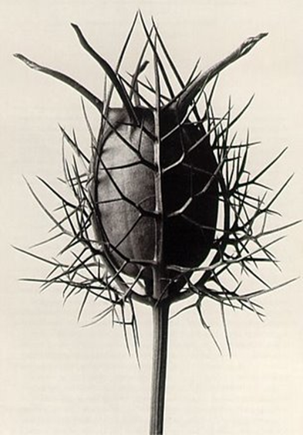
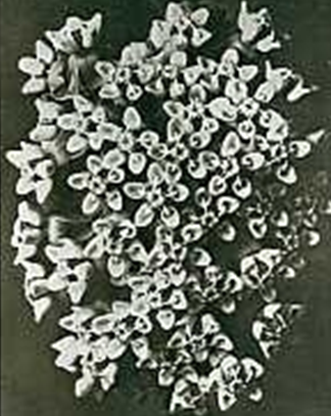
Use these questions to write 1-2 paragraphs about the Artists’ work
HOW TO DISCUSS ARTISTS WORK…
1) What is the subject of the photograph?
2) How has the subject been photographed?
(Close up, angle, section, viewpoint)
3) What is the composition of the photograph?
(How has the subject been framed? - centre, top, bottom - describe the overall layout
4) Describe what you can see…
(line, shapes, pattern, colour, tone, detail, texture?)
5) Is it realistic / abstract? – can you recognise what it is?
7) Do you like / dislike the work? WHY?
8) Do you get any ideas for your own work?
9) Any other important information about the photographer?

