Slide 1
GCSE Religious Studies Islam-Practices and Teachings
Name:

Slide 2
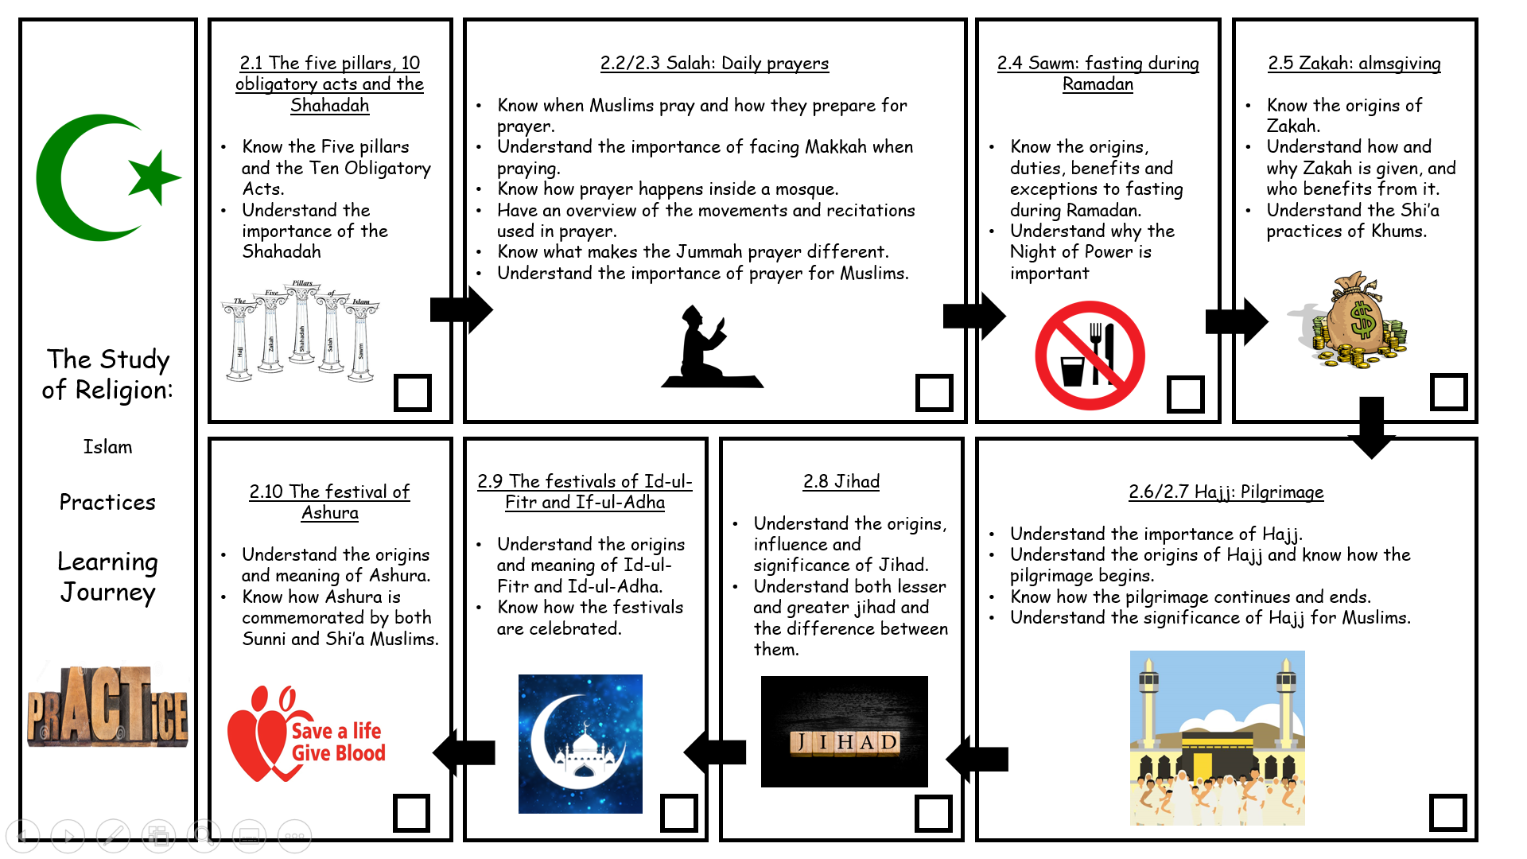
Islam Practices- Work Booklet
Link to the Textbook on Frog:
https://drive.google.com/file/d/14ceomkip0sC2Pf7evtKfweGbevObqKkB/view

Slide 3
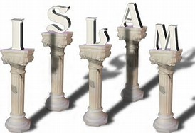
2.1 The five pillars, 10 obligatory acts and the Shahadah-
P32-33 of Islam Textbook
Know the Five pillars and the Ten Obligatory Acts.
Understand the importance of the Shahadah
Task A: Key Word Match- Research to help you/ Use the textbook
The Five Pillars
The Ten Obligatory Acts
Shahadah
The five most important cuties for all Muslims; to believe, to pray, to give to charity, to fast and to go on pilgrimage.
The Muslim declaration of faith.
Ten important duties for Shi’a Muslims, which include the 5 pillars.
Task B: Find out what the 5 pillars of Islam are, including the Arabic names.
1)
2)
3)
4)
5)
They are called pillars as they support the main principles and beliefs of Islam (like pillars hold up a building).
They are central to Muslims practices and they have great impact on a Muslim’s daily life.
They are a key way to live a perfect life.
They help to give Muslims an identity as one community who share a faith, and enable them to show their obedience and dedication to God.
1

Slide 4
2.1 The five pillars, 10 obligatory acts and the Shahadah-
P32-33 of Islam Textbook
Know the Five pillars and the Ten Obligatory Acts.
Understand the importance of the Shahadah
The Ten Obligatory Acts in Shi’a Islam
For Muslims who follow Twelver Shi’a Islam, there are ten duties called the 10 obligatory acts.
These include all the five pillars except Shahadah (which is covered by some of the additional acts.
Task C: Use P32-33 and write down what the 10 obligatory acts are with a brief explanation
Add an image to each to help you remember them!
Image | Name | Information
2

Slide 5
2.1 The five pillars, 10 obligatory acts and the Shahadah-
P32-33 of Islam Textbook
Know the Five pillars and the Ten Obligatory Acts.
Understand the importance of the Shahadah
The Shahadah
The basic belief of Islam is expressed in the Shahadah.
Sincerely reciting the statement in front of Muslim witnesses is the only requirement for joining the Muslim community.
It is recited many time during a lifetime.
It is said when a baby is born, so the first thing they hear is the basic belief that they have been brought into.
It is also included in their daily prayers.
If possible, it should also be the last words of a Muslims before they die.
Task D: Pick the quote apart- Explain what it means to Muslims
“La ilaha illa Allah wa- Muhammad rasul Allah.”
“There is no God but Allah and Muhammad is the Prophet of Allah.”
The Shahadah
Why is the Shahadah important?
It is the first of the five pillars.
The Shahadah also provides the foundation for the other four pillars- these actions are expressed through the Shahadah.
This is also the same for the other 10 obligatory acts.
The Shahadah in Shi’a Islam
Shi’a Muslims add an extra phrase to their Shahadah.
This extra phrase demonstrates their belief that Ali, Muhammad’s cousin and son-in-law, was the true successor of Muhammad, and that only he and his descendants know the true meaning of the revelation given to Muhammad (the Qur'an).
Task E: Pick the quote apart- Explain what the Shahadah shows/ means for Shi’a Muslims
“There is no God but Allah and Muhammad is the Prophet of Allah and Ali is the friend of God.”
The Shahadah according to Shi’a Muslims
3

Slide 6
2.1 The five pillars, 10 obligatory acts and the Shahadah-
P32-33 of Islam Textbook
Know the Five pillars and the Ten Obligatory Acts.
Understand the importance of the Shahadah
GCSE 2 Marker Practice Question:
Name two of the Five Pillars of Islam
1)_________________________________________________________________
2) ________________________________________________________________
GCSE 4 Marker
Explain two Shi’a Muslim beliefs about the 10 obligatory acts
____________________________________________________________________________________________________________________________________
__________________________________________________________________
__________________________________________________________________
____________________________________________________________________________________________________________________________________
__________________________________________________________________
__________________________________________________________________
GCSE 5 Marker
Explain two Muslim beliefs about the Shahadah
Refer to a religious source/ quote in your answer
____________________________________________________________________________________________________________________________________
__________________________________________________________________
__________________________________________________________________
____________________________________________________________________________________________________________________________________
__________________________________________________________________
__________________________________________________________________
__________________________________________________________________
__________________________________________________________________
__________________________________________________________________
__________________________________________________________________
__________________________________________________________________
4

Slide 7
2.2/2.3 Salah: Daily prayers
P34-37 of the Islam Textbook
Know when Muslims pray and how they prepare for prayer.
Understand the importance of facing Makkah when praying.
Know how prayer happens inside a mosque.
Have an overview of the movements and recitations used in prayer.
Know what makes the Jummah prayer different.
Understand the importance of prayer for Muslims
Task A: Key Word Match- Research to help you/ Use the textbook
Salah
Wudu
Mihrab
Qiblah wall
Rak’ah
Recitation
Prostration
Jummah Prayer
A weekly communal prayer performed after midday on Friday, which includes a sermon.
Repeating a passage of text from memory.
Ritual washing before prayer
A Niche in a wall that indicates the direction of Makkah.
A sequence of movements in ritual prayer.
Kneeling with the forehead, nose, hands, knees and toes touching the floor, in submission to God.
Prayer with and in worship of God, performed under condition set by Prophet Muhammad.
A wall in the mosque that contains the Mihrab.
Prayer
A Muslim prays as if they are standing in the presence of Allah.
It the ritual prayers each individual Muslim is in direct contact with Allah.
There is no need for a priest as an intermediary (while there is a prayer leader in the mosque- the imam- they are not a priest, simply a person who knows a great deal about Islam and can advise Muslims about the beliefs and teachings of Islam.
Task B:
Mind map
What is the purpose of prayer?
5

Slide 8
2.2/2.3 Salah: Daily prayers
P34-37 of the Islam Textbook
Know when Muslims pray and how they prepare for prayer.
Understand the importance of facing Makkah when praying.
Know how prayer happens inside a mosque.
Have an overview of the movements and recitations used in prayer.
Know what makes the Jummah prayer different.
Understand the importance of prayer for Muslims
The Times of Prayer
Sunni Muslims are required to pray at 5 set times during the day.
The times are worked out from the times of sunrise and sunset, so they change slightly each day.
This also changes depending on where you are in the world.
The first prayer is earlier in the summer than the winter because sunrise is earlier.
This places demands upon Muslims but is all part of the self-discipline required to submit themselves to God.
Shi’a Muslims combine the midday and afternoon prayers, and the sunset and night prayers, they do the 5 prayers but 3 times a day.
Task C: What benefits do you think Muslims would get from regular prayer?
Fajr | Just before sunrise
Zuhr | Just after midday
Asr | Afternoon
Maghrib | After sunset
Isha | Night
Preparing for prayer
It is important that Muslims are spiritually clean before they pray.
This is achieved by ritual washing (or ablution) called wudu.
Muslims follow detailed instruction in order to make sure that they do this properly.
Mosques have two special rooms set aside for washing, one for men and one for women,
Washing is done under running water rather than using a basin.
If water is not available, for example in a desert, a dry form of washing is allowed using sand or dust.
It is about spiritual cleanliness not physical
It gets Muslims prepared to fully focus on God.
Task D: Pick the quote apart- Explain what it tells Muslims to do before prayer
“ You who believe, when you are about to pray, wash your faces and your hands up to the elbows, wipe your heads, wash your feet up to the ankles and, if required, wash you whole body.”
Qur’an 5:6
6

Slide 9
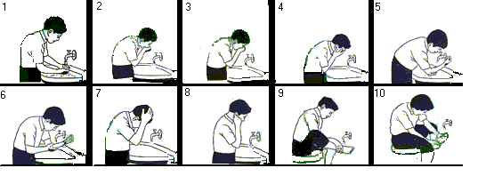
2.2/2.3 Salah: Daily prayers
P34-37 of the Islam Textbook
Know when Muslims pray and how they prepare for prayer.
Understand the importance of facing Makkah when praying.
Know how prayer happens inside a mosque.
Have an overview of the movements and recitations used in prayer.
Know what makes the Jummah prayer different.
Understand the importance of prayer for Muslims
Task E: Label the diagram using the next page- (the information sheet) They do not match so read it carefully and look at the images!
Step 1 on the other page would be before this image 1 so make clear points.
Task F: Use the information at the bottom and explain what makes Muslims loose Wudu
7

Slide 10
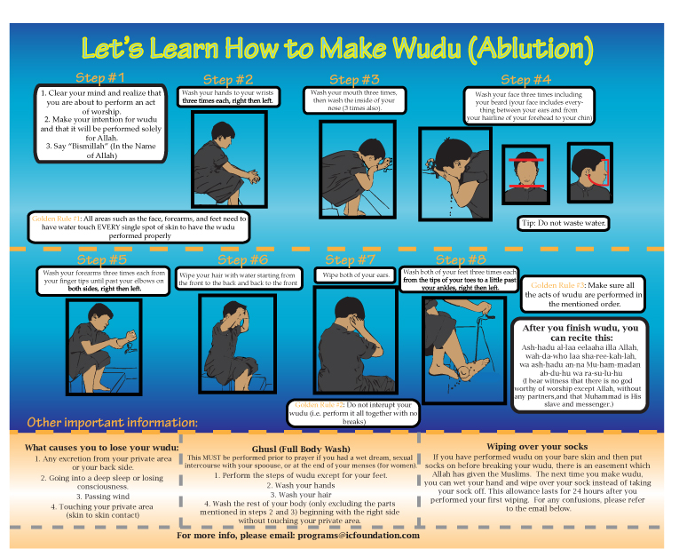
Wash your face 3 times including your beard, hairline and chin
Wash both feet 3 times each from tips of your toes to a little past your ankle
Wash mouth 3 times then inside your nose 3 times
Wipe both ears
Wash hands to wrists, 3x each, right then left
Wipe hair with water from front to back then back to front
Clear your mind and realise you are going to perform the act
Make your intention for wudhu
Say “Bismillah”
Wash forearms 3 times each from finger tips to elbows, right then left
8

Slide 11
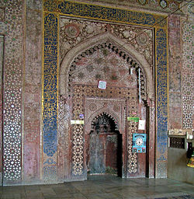
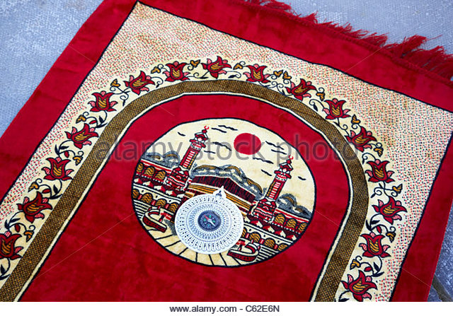
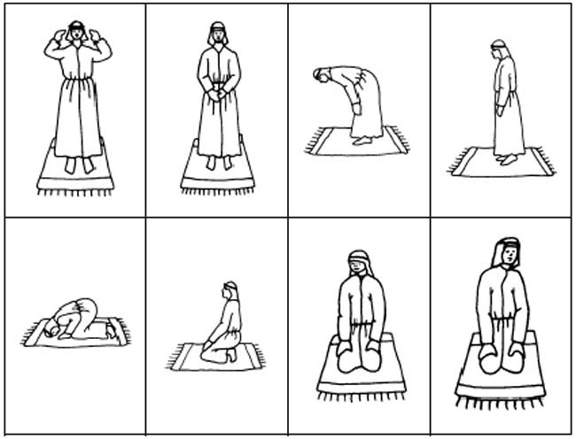
2.2/2.3 Salah: Daily prayers
P34-37 of the Islam Textbook
Know when Muslims pray and how they prepare for prayer.
Understand the importance of facing Makkah when praying.
Know how prayer happens inside a mosque.
Have an overview of the movements and recitations used in prayer.
Know what makes the Jummah prayer different.
Understand the importance of prayer for Muslims
How do Muslims pray?
It is very important that Muslims face the holy city of Makkah when they pray.
This means that Muslims are physically and mentally focusing on one place associated with God, in the same way that all Muslims should focus every part of their lives on God.
All mosques have a mihrab, this is a semi-circular niche built into the qiblah wall, which shows the exact direction of Makkah from the mosque, so Muslims face this way to pray.
If prayer is taking place outside the mosque, may Muslims have a special compass to show the direction of Makkah. It is sometimes part of the mat that Muslims kneel on when they pray.
Mihrab on the qiblah wall
Compass on a prayer mat
How do Muslims pray?
The daily prayers are made up of a number of rak’ah.
This is a sequence of actions and recitations.
The rak’ah changes slightly depending on which prayer it is used in, and whereabouts it occurs in the overall sequence, but it includes the following basic actions (all recitations are said in Arabic)
Task G: Use p36 and label the diagram explaining the position and what is recited by Muslims during the rak’ah.
9

Slide 12
2.2/2.3 Salah: Daily prayers
P34-37 of the Islam Textbook
Know when Muslims pray and how they prepare for prayer.
Understand the importance of facing Makkah when praying.
Know how prayer happens inside a mosque.
Have an overview of the movements and recitations used in prayer.
Know what makes the Jummah prayer different.
Understand the importance of prayer for Muslims
Task H: Explain what Muslims do with their personal prayer after they have finished the rak’ahs
Task I: Complete the questions about prayer at home and in the Mosque using P35 and P37 of the textbook (they have clear subheadings)
Prayer inside a mosque
What do many mosques have? What does it face? | Who are prayers led by? | How do men and women pray? Why do you think this is?
Prayer at the home
Muslims can pray at home- what must they do? What do they need/ not need? | What will many Muslims use? Where do they face? | Why is it easier for women?
10

Slide 13
2.2/2.3 Salah: Daily prayers
P34-37 of the Islam Textbook
Know when Muslims pray and how they prepare for prayer.
Understand the importance of facing Makkah when praying.
Know how prayer happens inside a mosque.
Have an overview of the movements and recitations used in prayer.
Know what makes the Jummah prayer different.
Understand the importance of prayer for Muslims
The Jummah Prayer
This is the midday prayer every Friday which is considered to be special.
All male Muslims are expected to attend a mosque for this prayer, and women may do so if they wish.
Once the prayer is complete, the imam will deliver a sermon that reminds Muslims of their obligations and duties to God.
Although Friday is not a day of rest, Muslims must leave their work or close their business in order to attend the Jummah prayer, and then return to work afterwards.
Task J: Explain what the quote teaches Muslims about the Jummah prayer
“Believers! When the call to prayer is made on the day of congregation, hurry towards the reminder of God and leave off your trading.”
Qur’an 62:9
Task K: Explain why you think Muslim women might not have to go to Jummah prayer on a Friday
Why is prayer important?
It is one of the five pillars.
It builds a relationship with God.
Muslims believe they are communicating/ speaking directly to God.
God commands Muslims to pray.
Prayer creates an awareness of God, which motivates them to do God’s will.
Prayer unites Muslims worldwide because they all pray in the same way.
A Muslim can go into any mosque anywhere in the world and be able to participate with fellow Muslims.
Mind, body and soul- worship
It reminds Muslims of the importance of the Qur’an
The actions of bowing and prostrating reminds them that God is greater and more importance than they are.
It is something Muhammad instructed of Muslims after the Night Journey- he was instructed by previous prophets.
Task L: Explain what the quotes teach Muslims about the importance of prayer
“Your Lord says, ‘Call on Me and I will answer you.”
Qur’an 40:60
“So woe to those who pray but are heedless of their prayers.”
Qur’an 107:4-5
11

Slide 14
2.2/2.3 Salah: Daily prayers
P34-37 of the Islam Textbook
Know when Muslims pray and how they prepare for prayer.
Understand the importance of facing Makkah when praying.
Know how prayer happens inside a mosque.
Have an overview of the movements and recitations used in prayer.
Know what makes the Jummah prayer different.
Understand the importance of prayer for Muslims
GCSE 2 Marker Practice Question: - Name two rak’ahs
1)_________________________________________________________________
2) ________________________________________________________________
GCSE 5 Marker - Explain two reasons why performing wudu is important to Muslims
Refer to a religious source/ quote in your answer
____________________________________________________________________________________________________________________________________
__________________________________________________________________
__________________________________________________________________
____________________________________________________________________________________________________________________________________
__________________________________________________________________
__________________________________________________________________
__________________________________________________________________
__________________________________________________________________
__________________________________________________________________
GCSE 5 Marker - Explain two reasons why prayer is important to Muslims.
Refer to a religious source/ quote in your answer
____________________________________________________________________________________________________________________________________
__________________________________________________________________
__________________________________________________________________
____________________________________________________________________________________________________________________________________
__________________________________________________________________
__________________________________________________________________
__________________________________________________________________
__________________________________________________________________
__________________________________________________________________
12

Slide 15
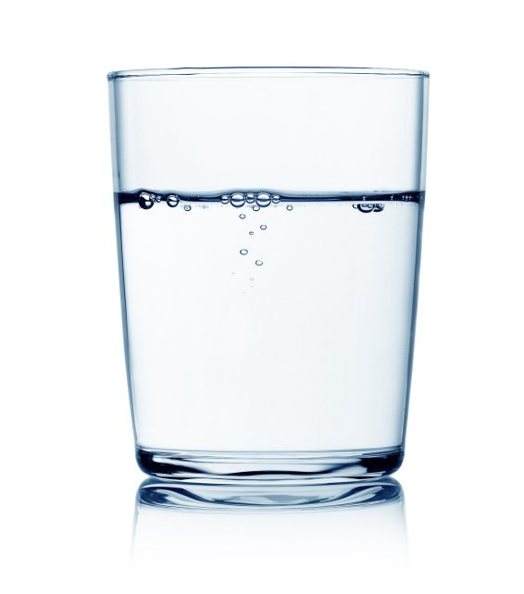
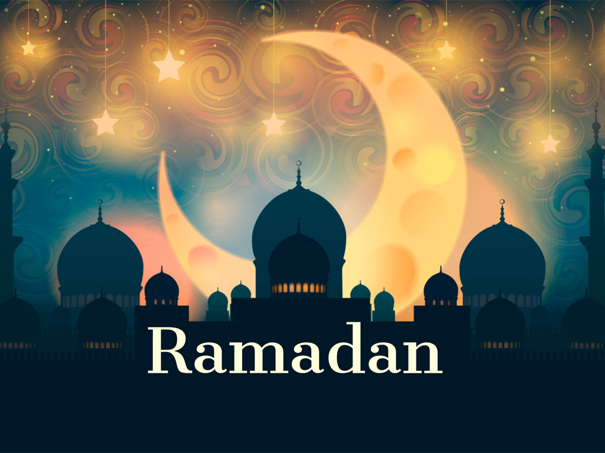
2.4 Sawm: fasting during Ramadan
P38-39 of the Islam Textbook
Know the origins, duties, benefits and exceptions to fasting during Ramadan.
Understand why the Night of Power is important
Task A: Key Word Match- Research to help you/ Use the textbook
Ramadan
Fasting
The Night of Power
The night when the first revelation of the Qur’an was made to Muhammad.
Not eating or drinking for a certain length of time, usually for a religious reason.
The ninth month of the Muslim calendar, during which Muslims have to fast from duck to sunset.
Task B: Make a list of everything you have eaten and drank since you woke up this morning
Task C: Do you think it would be difficult to not drink water at all during the day? Explain your answer
Ramadan
Ramadan is the ninth month of the Islamic calendar and for Muslims, the most important.
They believe it was during Ramadan that the Qur’an started to be revealed to Muhammad.
Many Muslims will recite the whole Qur’an, in daily section, over the 30 days of Ramadan.
The daily readings from the Qur’an help Muslims to remember its teachings and its importance in their lives.
During the month of Ramadan, Muslims focus on fasting (sawm), charity and pleasing God.
Videos to help you understand what Ramadan is and how Muslims feel during Ramadan:
https://www.youtube.com/watch?v=s-zZvH_mXTw
https://www.youtube.com/watch?v=Gd_9ZP62sMg
https://www.youtube.com/watch?v=-6vfsYwXW6I
https://www.youtube.com/watch?v=_PnlMftGFmQ
https://www.youtube.com/watch?v=oVEbDQSN4N4
https://www.youtube.com/watch?v=opk1_MhuX9Q
13

Slide 16
2.4 Sawm: fasting during Ramadan
P38-39 of the Islam Textbook
Know the origins, duties, benefits and exceptions to fasting during Ramadan.
Understand why the Night of Power is important
Fasting
Task D: Complete the question on fasting using P38-39
What is Ramadan known as? Why? | What do Muslims do? | Where can the command be found? When did fasting begin? | What else are Muslims not allowed to do? | Why is it difficult for Muslims who live in non-Muslim countries?
What do Muslims focus on during Ramadan?
Task E:
Mind map
Who does not need to fast and why?
14

Slide 17
2.4 Sawm: fasting during Ramadan
P38-39 of the Islam Textbook
Know the origins, duties, benefits and exceptions to fasting during Ramadan.
Understand why the Night of Power is important
Task F: Explain what the quote teaches Muslims about who needs to/does need to fast
“It was the month of Ramadan that the Qur’an was revealed as guidance for mankind… So any one of you who is present that month should fast, and anyone who is ill or on a journey should make up for the lost days by fasting on other days later.”
Qur’an 2:18
Charity
Feeling hunger is a positive reminder that the poor feel that way all the times if they have no money.
This inspires Muslims to find ways to help the poor.
This may include inviting the poor to share their meal that break the fast at sunset.
Many Muslims choose to pay Zakah during Ramadan.
The Night of Power
The Night of Power is an important festival that marks the beginning of God’s revelation to Muhammad.
The exact date this happened is not agreed on, but it is believed to be one of the odd-numbered dates in the second half of Ramadan.
The first verses of the Qur’an were revealed to Muhammad this night by the angel Jibril.
Video to help you understand the night of power:
https://www.youtube.com/watch?v=QcSB-F1PJpY
Task G: Explain what the quote teaches Muslims about the night of Power
“Read! In the name of your Lord who created: He created man from a clinging form [a blood clot]. Read! Your Lord is the Most Bountiful One who taught by [means of] the pen, who taught man what he did not know.”
Qur’an 96:1-5
15

Slide 18
2.4 Sawm: fasting during Ramadan
P38-39 of the Islam Textbook
Know the origins, duties, benefits and exceptions to fasting during Ramadan.
Understand why the Night of Power is important
Task H: Explain what the quote show about the Night of Power’s importance
“What will explain to you what that Night of Glory is? The Night of Glory is better than a thousand months.”
Qur’an 97:2-3
Muslims will try to keep awake throughout the night on each of the possible dates, devoting themselves to prayers and studying the Qur’an.
GCSE 4 Marker - Explain two ways that sawm influences Muslims today.
____________________________________________________________________________________________________________________________________
__________________________________________________________________
__________________________________________________________________
____________________________________________________________________________________________________________________________________
__________________________________________________________________
__________________________________________________________________
GCSE 5 Marker - Explain two reasons why the Night of Power is important to Muslims.
Refer to a religious source/ quote in your answer
____________________________________________________________________________________________________________________________________
__________________________________________________________________
__________________________________________________________________
____________________________________________________________________________________________________________________________________
__________________________________________________________________
__________________________________________________________________
__________________________________________________________________
__________________________________________________________________
__________________________________________________________________
16

Slide 19
2.4 Sawm: fasting during Ramadan
P38-39 of the Islam Textbook
Know the origins, duties, benefits and exceptions to fasting during Ramadan.
Understand why the Night of Power is important
Task: GCSE 12 Marker Plan
“It is easier to observe Ramadan in a Muslim country than it is in the UK.” Evaluate this statement
Agree- It is easier | Disagree- It is not easier/ same difficulty
GCSE 12 Marker- “It is easier to observe Ramadan in a Muslim country than it is in the UK.”
____________________________________________________________________________________________________________________________________
__________________________________________________________________
__________________________________________________________________
____________________________________________________________________________________________________________________________________
__________________________________________________________________
____________________________________________________________________________________________________________________________________
__________________________________________________________________
__________________________________________________________________
__________________________________________________________________
__________________________________________________________________
__________________________________________________________________
__________________________________________________________________
__________________________________________________________________
__________________________________________________________________
__________________________________________________________________
__________________________________________________________________
17

Slide 20
__________________________________________________________________
__________________________________________________________________
____________________________________________________________________________________________________________________________________
__________________________________________________________________
__________________________________________________________________
____________________________________________________________________________________________________________________________________
__________________________________________________________________
____________________________________________________________________________________________________________________________________
__________________________________________________________________
__________________________________________________________________
__________________________________________________________________
__________________________________________________________________
__________________________________________________________________
__________________________________________________________________
__________________________________________________________________
__________________________________________________________________
__________________________________________________________________
__________________________________________________________________
__________________________________________________________________
__________________________________________________________________
__________________________________________________________________
__________________________________________________________________
__________________________________________________________________
__________________________________________________________________
__________________________________________________________________
__________________________________________________________________
____________________________________________________________________________________________________________________________________
__________________________________________________________________
__________________________________________________________________
__________________________________________________________________
__________________________________________________________________
18

Slide 21
2.5 Zakah: almsgiving
P40-41 of the Islam Textbook
Know the origins of Zakah.
Understand how and why Zakah is given, and who benefits from it.
Understand the Shi’a practices of Khums.
Task A: Key Word Match- Research to help you/ Use the textbook
Zakah
Sadaqah
Khums
Purification of wealth by giving 2.5% of savings each year to the poor.
A 20% tax paid by Shi’a Muslims on their excess income.
Good actions or voluntary payments that are undertaken for charitable reasons.
Task B: Use P40-41 to answer the following questions and explain what the quotes mean.
Follow the subheadings to help you understand what you are answering
What is Zakah?
What is Zakah? When will Muslims give it? | What are Muslims acknowledging by giving Zakah? | What does Zakah mean?
The Origins of Zakah
“They ask you [Prophet] what they should give. Say, ‘Whatever you give should be for your parents, close relatives, orphans, the needy, and travellers. God is aware of whatever good you do.” Qur’an 2:215 | How was Zakah worked out?
19

Slide 22
2.5 Zakah: almsgiving
P40-41 of the Islam Textbook
Know the origins of Zakah.
Understand how and why Zakah is given, and who benefits from it.
Understand the Shi’a practices of Khums.
How is Zakah given? Who receives it?
Which Muslims give Zakah? How is Zakah worked out? | How is it donated? | Who receives Zakah? “Alms are meant only for the poor, the need, those who administer them, those hearts need winning over. To free slaves and help those in debt, for God’s cause and for travellers in need.” Qur’an 9:60 What else are Muslims encouraged to do?
Why is Zakah important?
It is one of the 5 pillars of Islam.
Giving Zakah is a duty imposed by God.
The Qur’an shows that you are a true Muslim if you give Zakah.
Paying Zakah gives Muslims a good attitude towards money
Teaches Muslims to share and not be greedy.
Zakah strengthens communities by making the rich support the poor.
Zakah links well with prayer/ fasting- they should make Muslims feel concern for others. Zakah puts concern into action.
Khums- Shi’a Muslims
Khums is an important part of Muslim practice in Shi’a Islam in addition to giving Zakah.
It means ‘fifth’. So Muslims are required to donate 20% of the spoils of war to the leader representing the state of Islam.
It refers to the excess income or earning that a Shi’a Muslim makes.
Half of the money collected as Khums goes to Shi’a religious leaders, to be spend on behalf of God on things considered necessary for religious matters.
While the rest is given to charity or the poor.
20

Slide 23
2.5 Zakah: almsgiving
P40-41 of the Islam Textbook
Know the origins of Zakah.
Understand how and why Zakah is given, and who benefits from it.
Understand the Shi’a practices of Khums.
GCSE 4 Marker - Explain two reasons why Zakah is important to Muslims
____________________________________________________________________________________________________________________________________
__________________________________________________________________
__________________________________________________________________
____________________________________________________________________________________________________________________________________
__________________________________________________________________
____________________________________________________________________________________________________________________________________
__________________________________________________________________
GCSE 4 Marker - Explain two Muslim beliefs about Khums
____________________________________________________________________________________________________________________________________
__________________________________________________________________
__________________________________________________________________
____________________________________________________________________________________________________________________________________
__________________________________________________________________
____________________________________________________________________________________________________________________________________
__________________________________________________________________
GCSE 2 Marker Practice Question: - Give two examples of who might receive Zakah
1)_________________________________________________________________
2) ________________________________________________________________
21

Slide 24
2.6/2.7 Hajj: Pilgrimage
P42-45 of the Islam Textbook
Understand the importance of Hajj.
Understand the origins of Hajj and know how the pilgrimage begins.
Know how the pilgrimage continues and ends.
Understand the significance of Hajj for Muslims.
Task A: Get thinking!
What is a pilgrimage?
Give examples of where people (including other faiths) might go on a pilgrimage.
Task B: Key Word Match- Research to help you/ Use the textbook
Pilgrimage
Hajj
Ka’aba
Hajji
The annual pilgrimage to Mecca that every Muslim should try and make at least once in their lifetime.
The black, cube- shaped building in the centre of the Grand Mosque in Mecca; the holiest place in Islam.
Someone who has completed Hajj.
A journey by a believer to a holy site for religious reasons, an act of worship and devotion.
What is Hajj?
A pilgrimage is a religious journey.
It is the fifth pillar of Islam.
It needs to be completed at least once in a Muslims lifetime provided they are healthy and wealthy enough to do so . Some communities will help provide support to a Muslims do they have the chance to achieve this pillar.
Hajj starts and ends in Mecca in Saudi Arabia
It takes place on the 8th to the 12th of Dhul-Hajjah, which is the last month of the Islamic calendar.
Around 3 million Muslims take part every year
Task C: Explain what the quote shows about pilgrimage
“Pilgrimage to the House is a duty owed to God by people who are able to undertake it.”
Qur’an 3:97
22

Slide 25
2.6/2.7 Hajj: Pilgrimage
P42-45 of the Islam Textbook
Understand the importance of Hajj.
Understand the origins of Hajj and know how the pilgrimage begins.
Know how the pilgrimage continues and ends.
Understand the significance of Hajj for Muslims.
Task D:
Mind map
Who might not have to/ be able to go to Mecca? Explain why
Task E: Complete the questions using the textbook p42 (The origins of Hajj)
What do Muslims believe happened around 4000 years ago? | What did Hajira do when she was suffering?
What did God tell Ibrahim to do? What did it become? | What happened centuries later? | What happened in 628-630CE?
23

Slide 26
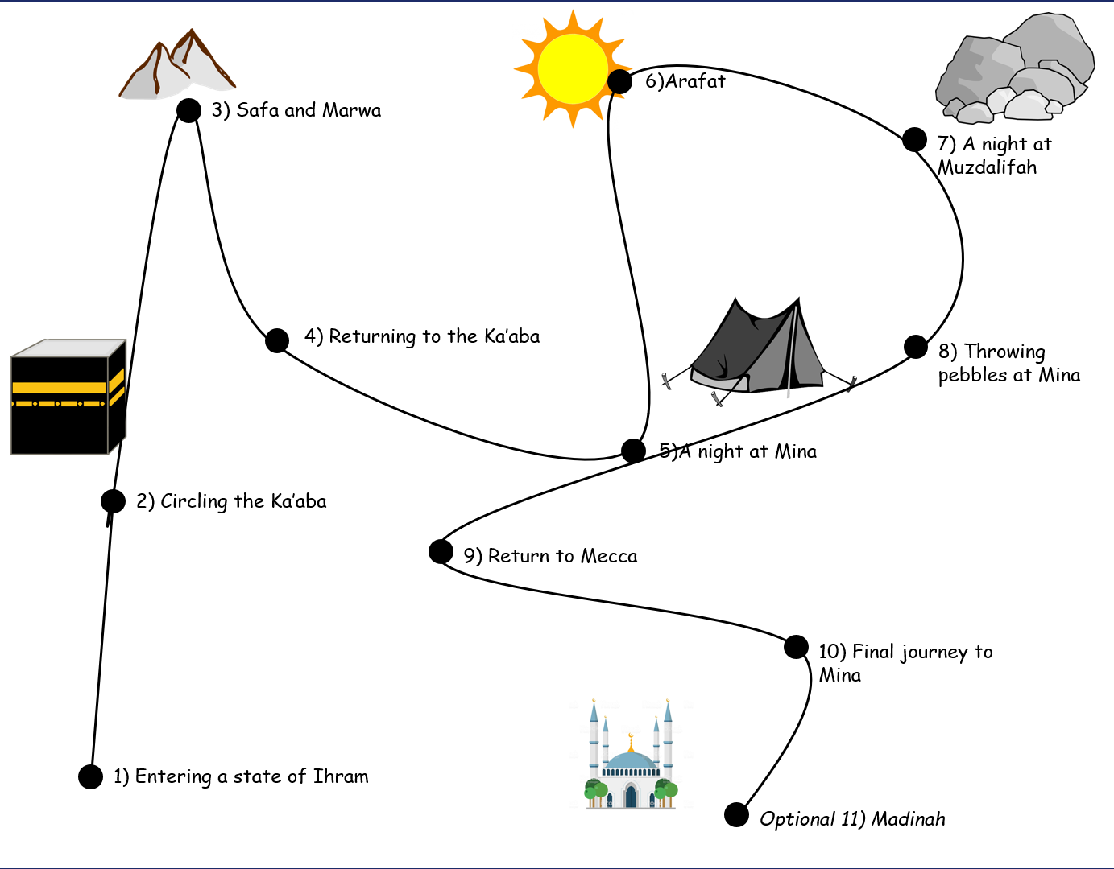
2.6/2.7 Hajj: Pilgrimage
P42-45 of the Islam Textbook
Understand the importance of Hajj.
Understand the origins of Hajj and know how the pilgrimage begins.
Know how the pilgrimage continues and ends.
Understand the significance of Hajj for Muslims.
Task F: Use p43-44 to complete the journey line of Hajj.
Read it- its not in clear subheadings in the textbook- read and follow the line.
Explain what happens at each point and why- what do they do it for?
Link it to historical figures- what did the prophets do there?
24

Slide 27
2.6/2.7 Hajj: Pilgrimage
P42-45 of the Islam Textbook
Understand the importance of Hajj.
Understand the origins of Hajj and know how the pilgrimage begins.
Know how the pilgrimage continues and ends.
Understand the significance of Hajj for Muslims.
Task G: Explain what the quote shows about Safa and Marwa and what it tells Muslims to do.
“Safa and Marwa are among the rites of God, so for those who make major or minor pilgrimage to the House it is no offence to circulate between the two.”
Qur’an 2:158
Why is Hajj important?
Muslims are given a special title Hajji (someone who has completed Hajj.)
It shows great discipline. It is both physically and mentally demanding. Not all are able to complete the full journey.
It emphasises equality. Their clothing ensures that there are no distractions between the rich and poor.
The tents that Muslims stay in at Mina show unity and strengthen the feeling of the Ummah (brotherhood/sisterhood)
It reminds Muslims of their historical stories of Adam, Ibrahim (and his family) and Prophet Muhammad.
It reminds Muslims of the ultimate commitment that Ibrahim made to God.
Muslims can be forgiven for their sins.
It can produce inner peace and can make Muslims act for justice, more honest, respectful, kind, merciful and forgiving.
It teaches Muslims sincerity and humility in a person’s relationship with God.
It can make Muslims better people as they might have a deep spiritual transformation- becoming more aware of God, his presence and are aware that he is watching them.
GCSE 4 Marker - Explain two reasons why Hajj is important to Muslims.
____________________________________________________________________________________________________________________________________
__________________________________________________________________
__________________________________________________________________
____________________________________________________________________________________________________________________________________
__________________________________________________________________
____________________________________________________________________________________________________________________________________
__________________________________________________________________
25

Slide 28
2.6/2.7 Hajj: Pilgrimage
P42-45 of the Islam Textbook
Understand the importance of Hajj.
Understand the origins of Hajj and know how the pilgrimage begins.
Know how the pilgrimage continues and ends.
Understand the significance of Hajj for Muslims.
Task: GCSE 12 Marker Plan
“Hajj is the most important of the 5 pillars of Islam” Evaluate this statement
Agree- Hajj is the most important | Disagree- it is not the most important/ all equal in importance/others are more important
GCSE 12 Marker- “Hajj is the most important of the 5 pillars of Islam” ____________________________________________________________________________________________________________________________________
__________________________________________________________________
__________________________________________________________________
____________________________________________________________________________________________________________________________________
__________________________________________________________________
____________________________________________________________________________________________________________________________________
__________________________________________________________________
__________________________________________________________________
__________________________________________________________________
__________________________________________________________________
__________________________________________________________________
__________________________________________________________________
__________________________________________________________________
__________________________________________________________________
__________________________________________________________________
__________________________________________________________________
26

Slide 29
__________________________________________________________________
__________________________________________________________________
____________________________________________________________________________________________________________________________________
__________________________________________________________________
__________________________________________________________________
____________________________________________________________________________________________________________________________________
__________________________________________________________________
____________________________________________________________________________________________________________________________________
__________________________________________________________________
__________________________________________________________________
__________________________________________________________________
__________________________________________________________________
__________________________________________________________________
__________________________________________________________________
__________________________________________________________________
__________________________________________________________________
__________________________________________________________________
__________________________________________________________________
__________________________________________________________________
__________________________________________________________________
__________________________________________________________________
__________________________________________________________________
__________________________________________________________________
__________________________________________________________________
__________________________________________________________________
__________________________________________________________________
____________________________________________________________________________________________________________________________________
__________________________________________________________________
__________________________________________________________________
__________________________________________________________________
__________________________________________________________________
27

Slide 30
2.8 Jihad
P46-47 of the Islam Textbook
Understand the origins, influence and significance of Jihad.
Understand both lesser and greater jihad and the difference between them.
Task A: Key Word Match- Research to help you/ Use the textbook
Jihad
Greater Jihad
Lesser Jihad
Holy War
The personal inward struggle for all Muslims to love in line with the teaching of their faith.
The outward struggle to defend one’s faith, family and country from threat.
Fighting for a religious cause or God, probably controlled by a religious leader.
The struggle against evil; this may be an inward, personal struggle or an outward, collective struggle.
Task B: Watch the video and answer the questions.
https://www.truetube.co.uk/film/what-jihad
What is Jihad?
What types of Jihad are there? Explain them
Where did the term ‘Jihad’ come from?
Jihad and its link to war
What are the misconceptions about Jihad? (What is the term associated with that is wrong?)
28

Slide 31
2.8 Jihad
P46-47 of the Islam Textbook
Understand the origins, influence and significance of Jihad.
Understand both lesser and greater jihad and the difference between them.
What is Jihad important?
Jihad is the struggle against evil.
Jihad requires Muslims to strive to improve themselves and societies in a way that God would approve of.
Jihad appears many times in the Qur’an and the Hadith
Task C: Read the statement and decide whether it is Lesser or Greater Jihad and explain how
Statement | What type of Jihad? Why? | Statement | What type of Jihad? Why?
Greater Jihad is a personal inward struggle of all Muslims to live in line with the teaching of their faith |  | Part of this is to observes the 5 pillars- which brings them closer to God and are required.
In the early days of the faith, this was important when Muslims were being persecuted and they needed to protect their freedom to practise their religion |  | There are some instances in the Qur’an that appear to allow extreme violence in the name of lesser Jihad.
Some believe this means that war can be justified but not terrorism acts that harm innocent civilians. |  | Others will try and help improve the community by giving Zakah and extra money to charity.
Some will learn the Qur’an by heart which requires great discipline and patience. |  | Lesser jihad has been misinterpreted in modern times. Muslims extremists are often called Jihadists.
Some will work with the poor and vulnerable, both locally and globally |  | Muslims devote their lives to God by avoiding temptation and distractions like drugs and alcohol, greed and jealousy.
Lesser Jihad means it is less important. The outward struggle to defend Islam from threat |  | It is the constant struggle to purify one’s heart from all evil traits, and to establish instead all types of virtues.
29

Slide 32
2.8 Jihad
P46-47 of the Islam Textbook
Understand the origins, influence and significance of Jihad.
Understand both lesser and greater jihad and the difference between them.
Task D: Explain what the quotes mean and how they link to Jihad.
PYT- Which Jihad do they link to? Explain how
“This is my path, leading straight, so follow it, and do not follow other ways: they will lead you away from it. ‘This is what He commands you to do, so that you may refrain from wrongdoing.”
Qur’an 6:153
“But those who have believed, migrated and striven for God’s cause, it is they who can look forward to God’s mercy: God is most forgiving and merciful.”
Qur’an 2:218
Holy War
Holy war is a fight for a religious cause or for God.
The criteria for a holy war is:
It must only be declared by a fair religious leader.
It cannot be used to make people convert to Islam.
It must be in response to a threat to the faith.
It must not be used to gain territory or wealth.
It must be the last resort- all peaceful methods must have been tried first.
Task E: Do you think these rules are acceptable? Explain why. Do you agree with them all? Explain why your views might differ on some.
30

Slide 33
2.8 Jihad
P46-47 of the Islam Textbook
Understand the origins, influence and significance of Jihad.
Understand both lesser and greater jihad and the difference between them.
Task F: Explain how the quote links to Holy war and Jihad
“Repel evil with what is seen as better, than your enemy will become your friend.”
Surah 41:34
GCSE 2 Marker Practice Question: - Give two ways Muslims will overcome Greater Jihad
1)_________________________________________________________________
2) ________________________________________________________________
GCSE 4 Marker – Explain two contrasting beliefs about Jihad
____________________________________________________________________________________________________________________________________
__________________________________________________________________
__________________________________________________________________
____________________________________________________________________________________________________________________________________
__________________________________________________________________
____________________________________________________________________________________________________________________________________
__________________________________________________________________
GCSE 4 Marker – Explain two ways the belief in Jihad influences Muslims today.
____________________________________________________________________________________________________________________________________
__________________________________________________________________
__________________________________________________________________
____________________________________________________________________________________________________________________________________
__________________________________________________________________
____________________________________________________________________________________________________________________________________
__________________________________________________________________
31

Slide 34
2.9 The festivals of Id-ul-Fitr and If-ul-Adha
P48-49 of the Islam Textbook
Understand the origins and meaning of Id-ul-Fitr and Id-ul-Adha.
Know how the festivals are celebrated.
Id-ul-Fitr
A Muslim festival that celebrates the end of Ramadan
Id-ul-Adha
A Muslim festival that celebrated the Prophet Ibrahim’s/Abraham’s willingness to sacrifice his son for God.
Task A: Complete the questions on Id-ul-Fitr using p48 and 49 of the textbook
Add more from your own research
Id-Ul-Fitr
What are the origins of the festival?
How is it celebrated?
Why is it important?
32

Slide 35
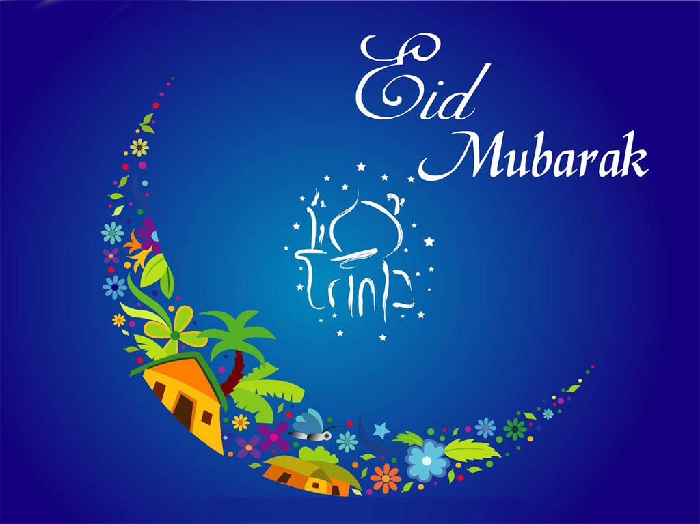
2.9 The festivals of Id-ul-Fitr and If-ul-Adha
P48-49 of the Islam Textbook
Understand the origins and meaning of Id-ul-Fitr and Id-ul-Adha.
Know how the festivals are celebrated.
Task B: Complete the questions on Id-ul-Adha using p48 and 49 of the textbook
Add more from your own research
Id-Ul-Adha
What are the origins of the festival?
How is it celebrated?
Why is it important?
Some helpful videos and readings:
https://www.truetube.co.uk/film/eid-ul-fitr (Fitr)
https://www.truetube.co.uk/film/my-faith-eid (Fitr)
https://www.independent.co.uk/life-style/eid-al-fitr-when-ramadan-mubarak-meaning-definition-holiday-islam-a8941211.html (Fitr)
https://www.youtube.com/watch?v=mS8Qi10h75g (Adha)
33

Slide 36
2.9 The festivals of Id-ul-Fitr and If-ul-Adha
P48-49 of the Islam Textbook
Understand the origins and meaning of Id-ul-Fitr and Id-ul-Adha.
Know how the festivals are celebrated.
GCSE 2 Marker Practice Question: - Give two ways Muslims celebrate Id-ul-Fitr
1)_________________________________________________________________
2) ________________________________________________________________
GCSE 4 Marker – Explain two Muslim beliefs about Id-ul-Fitr
____________________________________________________________________________________________________________________________________
__________________________________________________________________
__________________________________________________________________
____________________________________________________________________________________________________________________________________
__________________________________________________________________
____________________________________________________________________________________________________________________________________
____________________________________________________________________________________________________________________________________
GCSE 4 Marker – Explain two ways the origins of Id-ul-Adha will influence Muslims
____________________________________________________________________________________________________________________________________
__________________________________________________________________
__________________________________________________________________
____________________________________________________________________________________________________________________________________
__________________________________________________________________
____________________________________________________________________________________________________________________________________
____________________________________________________________________________________________________________________________________
34

Slide 37
2.10 The festival of Ashura
P50-51 of the Islam Textbook
Understand the origins and meaning of Ashura.
Know how Ashura is commemorated by both Sunni and Shi’a Muslims
Ashura- A festival that is important for Shi’a Muslims in particular, who remember the battle of the Karbala and the death of Husayn on this day.
Task A: Watch the two clips and answer the 7 questions
https://www.youtube.com/watch?v=lsgsuPxat6A
https://www.youtube.com/watch?v=DNqUd13m3EQ
Who was martyred/ died?
Which denomination remembers this?
When did his death take place?
What will some Muslims do to celebrate?
Why do some Muslims make themselves bleed?
What could they do instead?
Why is this festival so importance for Muslims today?
Task B:Why do you think some people do not see Ashura as a ‘festival’?
Think about this compared to the other Id’s or Christmas
35

Slide 38
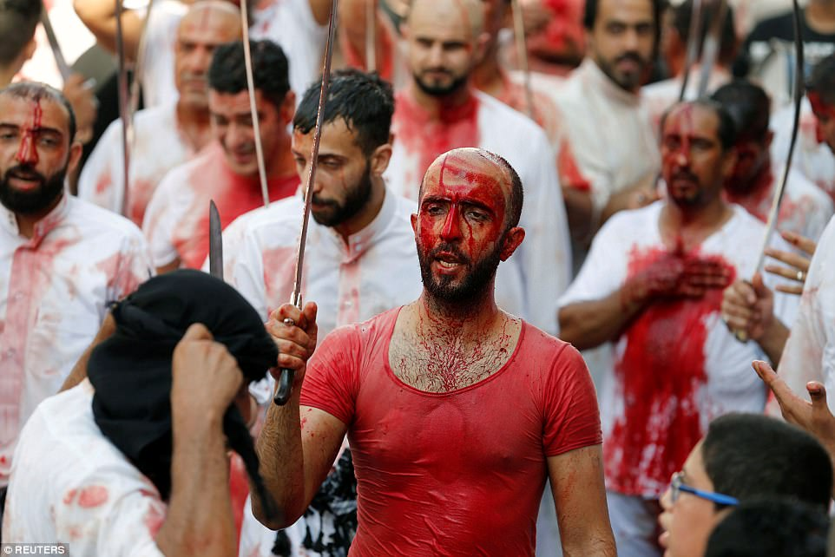
2.10 The festival of Ashura
P50-51 of the Islam Textbook
Understand the origins and meaning of Ashura.
Know how Ashura is commemorated by both Sunni and Shi’a Muslims
Task C: Using p50-51 complete the following sections
The history of the festival for Sunni Muslims.
The way Sunni Muslims celebrate the festival.
The history of the festival for Shi’a Muslims.
The way Shi’a Muslims celebrate the festival.
Task D: Using a highlighter- Highlight the similarities between the ways the denominations celebrate this festival
36

Slide 39
2.10 The festival of Ashura
P50-51 of the Islam Textbook
Understand the origins and meaning of Ashura.
Know how Ashura is commemorated by both Sunni and Shi’a Muslims
GCSE 2 Marker Practice Question: - Give two ways Shi’a Muslims celebrate Ashura
1)_________________________________________________________________
2) ________________________________________________________________
GCSE 4 Marker – Explain two contrasting beliefs about the origins of the festival of Ashura.
____________________________________________________________________________________________________________________________________
__________________________________________________________________
__________________________________________________________________
____________________________________________________________________________________________________________________________________
__________________________________________________________________
____________________________________________________________________________________________________________________________________
____________________________________________________________________________________________________________________________________
Task: GCSE 12 Marker Plan
“Ashura is the most important out of all the Muslim festivals” Evaluate this statement
Agree- Ashura is the most important | Disagree- Ashura is not the most important/ others are more important/ they are all equal
37

Slide 40
GCSE 12 Marker- ““Ashura is the most important out of all the Muslim festivals”
____________________________________________________________________________________________________________________________________
__________________________________________________________________
__________________________________________________________________
____________________________________________________________________________________________________________________________________
__________________________________________________________________
____________________________________________________________________________________________________________________________________
__________________________________________________________________
__________________________________________________________________
__________________________________________________________________
__________________________________________________________________
__________________________________________________________________
__________________________________________________________________
__________________________________________________________________
__________________________________________________________________
__________________________________________________________________
____________________________________________________________________________________________________________________________________
__________________________________________________________________
__________________________________________________________________
__________________________________________________________________
__________________________________________________________________
__________________________________________________________________
__________________________________________________________________
__________________________________________________________________
__________________________________________________________________
__________________________________________________________________
__________________________________________________________________
__________________________________________________________________
__________________________________________________________________
____________________________________________________________________________________________________________________________________
38

Slide 41
____________________________________________________________________________________________________________________________________
__________________________________________________________________
__________________________________________________________________
____________________________________________________________________________________________________________________________________
__________________________________________________________________
____________________________________________________________________________________________________________________________________
__________________________________________________________________
__________________________________________________________________
__________________________________________________________________
__________________________________________________________________
__________________________________________________________________
__________________________________________________________________
__________________________________________________________________
__________________________________________________________________
__________________________________________________________________
____________________________________________________________________________________________________________________________________
__________________________________________________________________
__________________________________________________________________
__________________________________________________________________
__________________________________________________________________
__________________________________________________________________
__________________________________________________________________
__________________________________________________________________
__________________________________________________________________
__________________________________________________________________
__________________________________________________________________
__________________________________________________________________
__________________________________________________________________
____________________________________________________________________________________________________________________________________
39

